Slide 1
Turning waste into resources for development
Principles for Inclusive Recycling
Mathias Schluep, World Resources Forum
16 May 2018, Kigali Rwanda

Slide 2
Content
World Resources Forum
Case studies recycling in the informal sector
  Secondary plastics in India
  Secondary Metals in Ghana
  ISO IWA Guidance Principles

Slide 3

The World Resources Forum Association (WRFA) is an independent non-profit international organization that serves as a platform connecting and fostering knowledge exchange on resources management amongst business leaders, policy-makers, NGOs, scientists and the public.
Flagship activity is the annual WRF Conference.

Slide 4
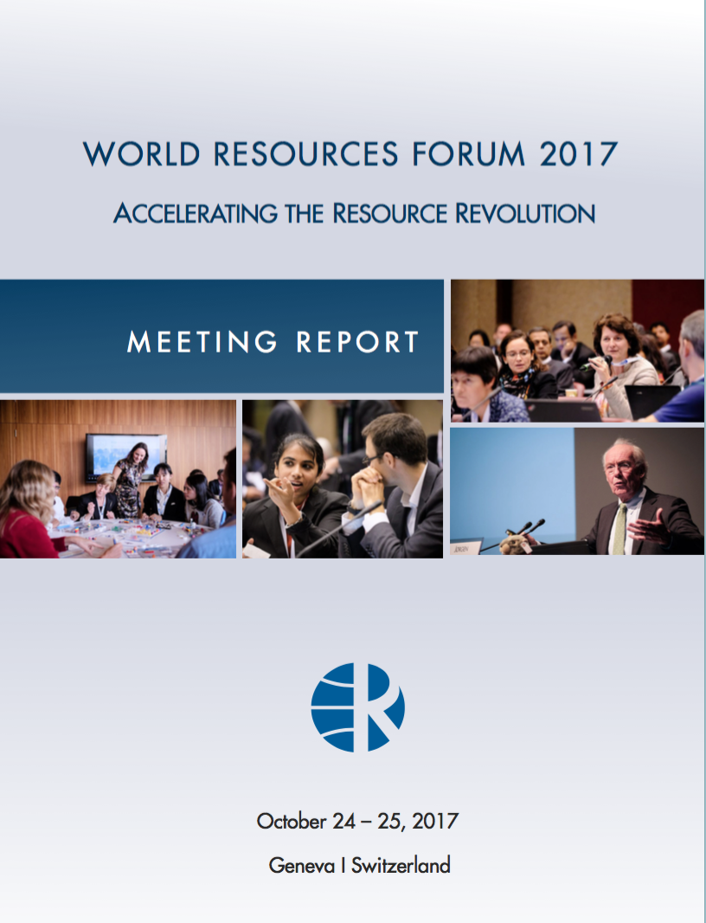






What we do
STAKEHOLDER DIALOGUE |  | KNOWLEDGE CENTRE |  | FLAGSHIP CONFERENCE
Leading multi-stakeholder processes that strengthen international cooperation and result in concrete action |  | Bringing knowledge closer to people by sharing research solutions with decision makers |  | Global and multidisciplinary 5000 – 1000 participants Knowledge exchange and debate
Advancing the idea of a World Forum on Raw Materials |  | UN Environment International Resource Panel online library |  | Interactive panels, lively discussions, workshops, side events and scientific sessions
Turning waste into resources for development |  | Resource Revolution Trainer (MOOC) Coupling sustainability with excellence |  | WRF Cinema and Photo & Art Gallery
Setting standards: International Workshop Agreement on Secondary Materials Recycling |  | The E-waste Challenge (MOOC) Taking action towards circular economy

Slide 5

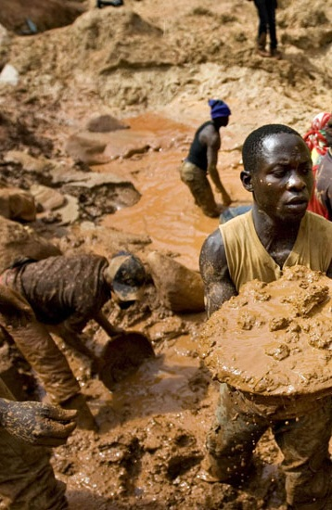
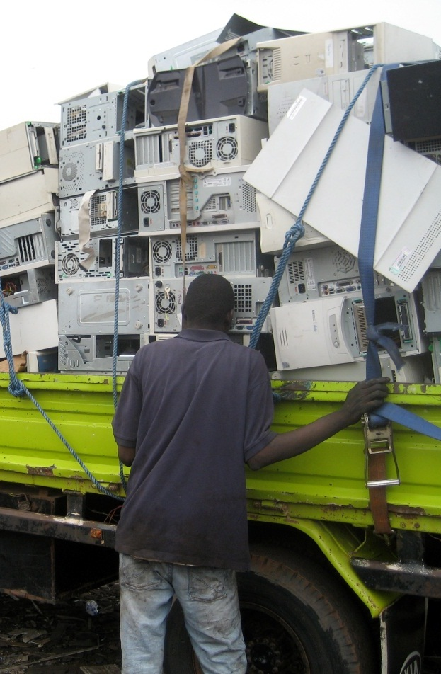



Developing countries are endowed with a variety of resources in large amounts
renewable
non-renewable
secondary
Quality and sustainability standards?
?

Slide 6
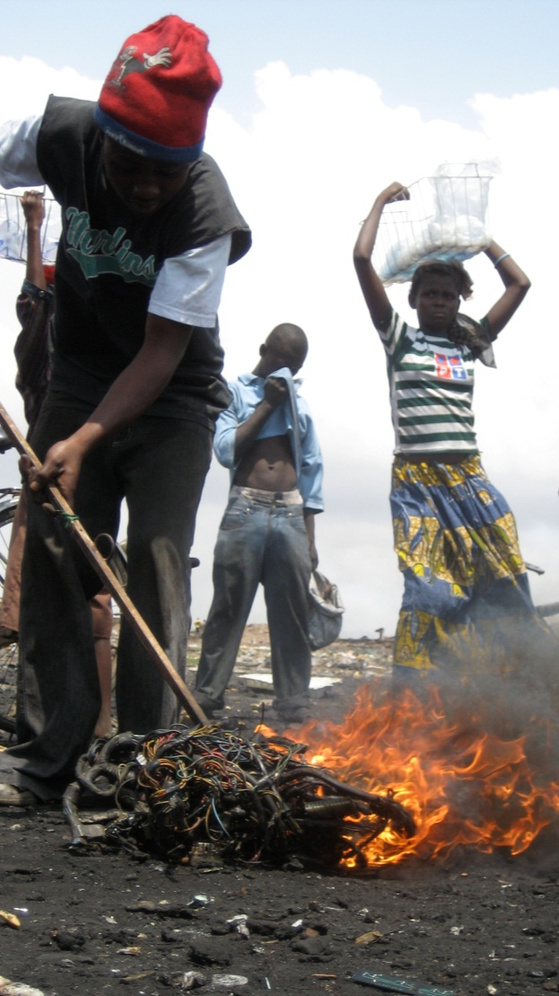

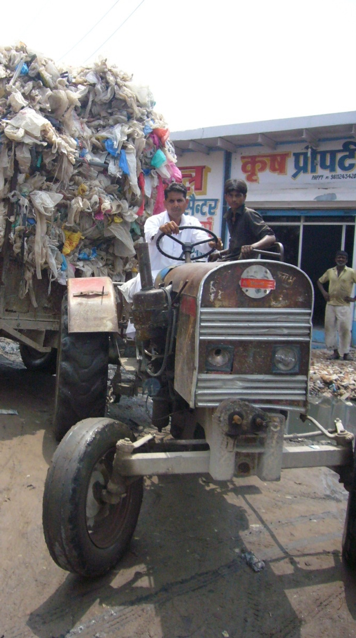

Recovery of secondary resources in developing countries is mainly an informal business posing threads and opportunities
Informality
Threads
Opportunity
~ 25’000 people work in the the informal plastic recycling sector in New Delhi, India
Environmental pollution, health hazards, cross-contamination
„Urban mining“

Slide 7
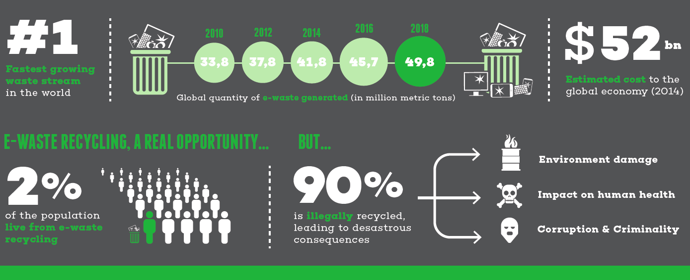
The Challenge of e-waste
of informal workers are dedicated to waste management
is informally recycled, leading to serious consequences
Informal sector integration (existing knowledge) is key to build a formal recycling industry

Slide 8
The informal recycling sector is the champion in circular economy
Figure: Plastic flows in India (2015). Size is relative to mass. Unit: million tonnes per year

Slide 10
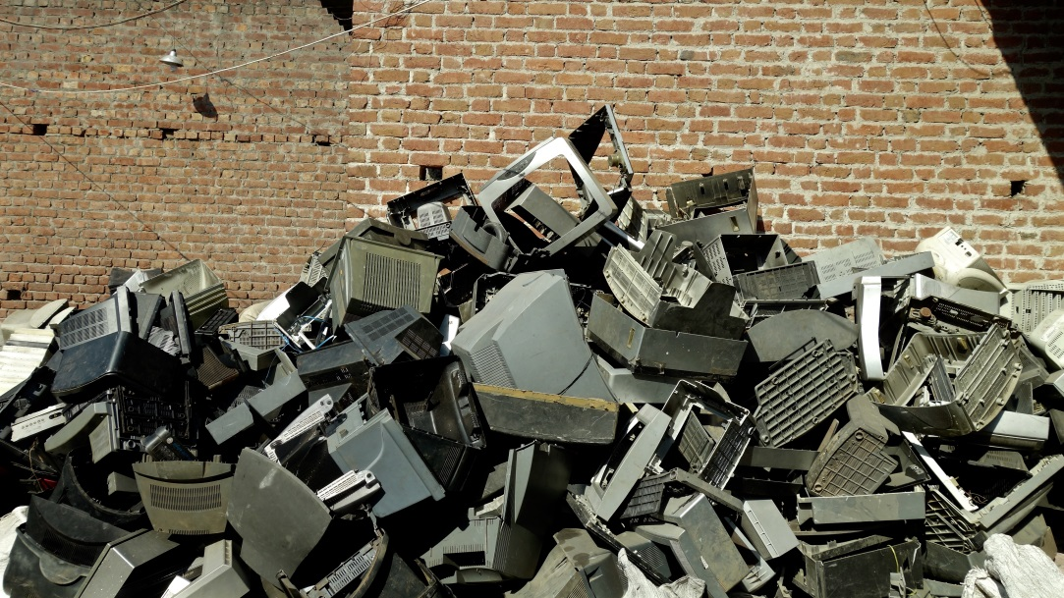
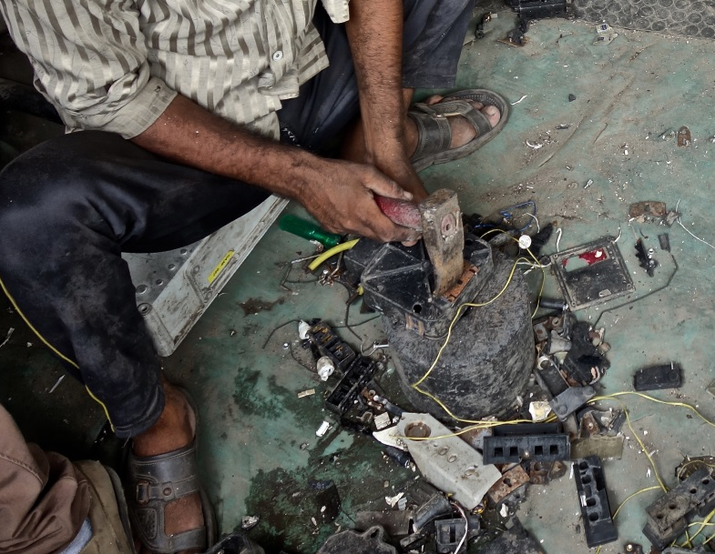
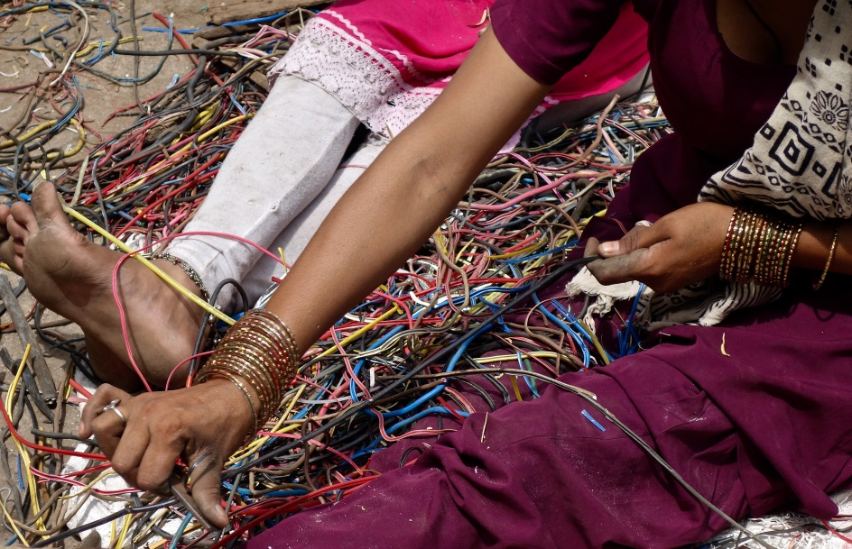
The recycling value chain (1/3)
Waste collection
Dismantling

Slide 11
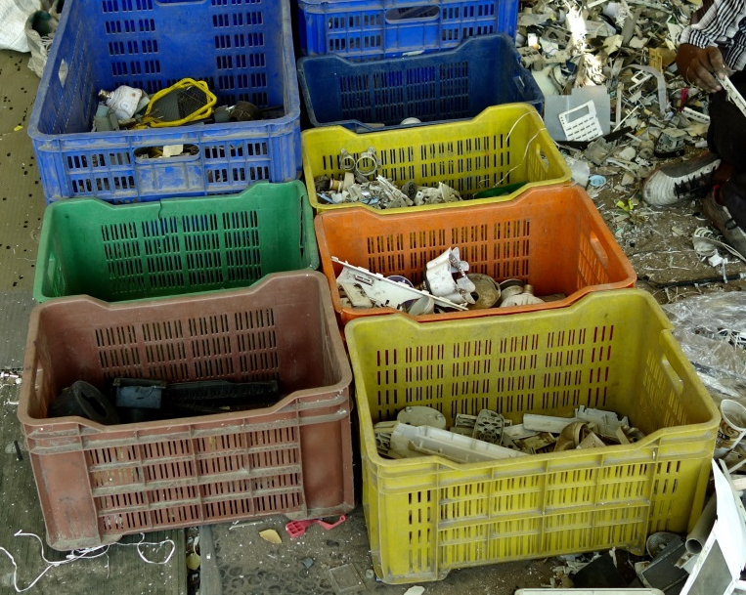
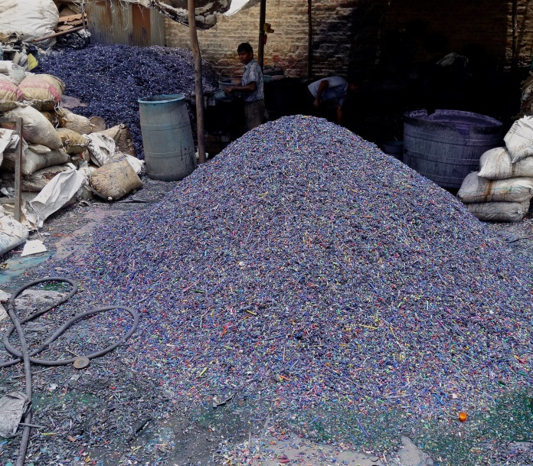
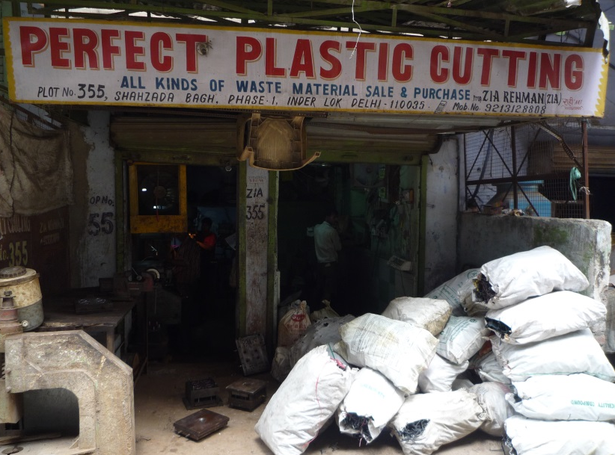
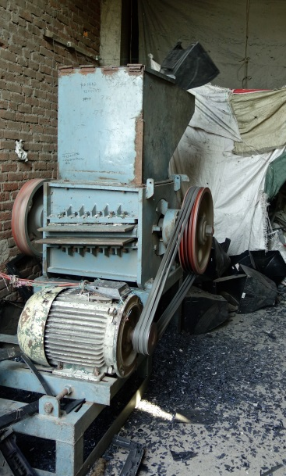
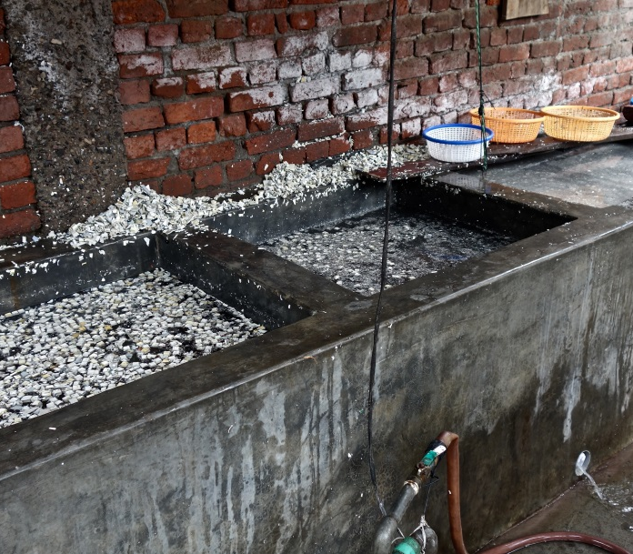
The recycling value chain (2/3)
Sorting
Shredding & Cleaning

Slide 12
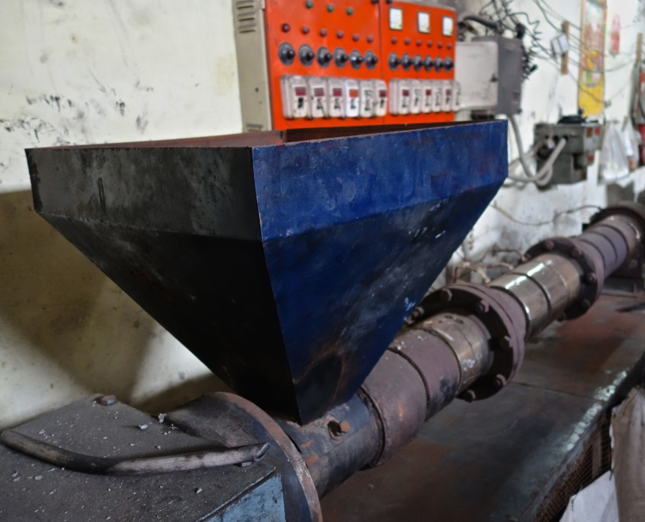
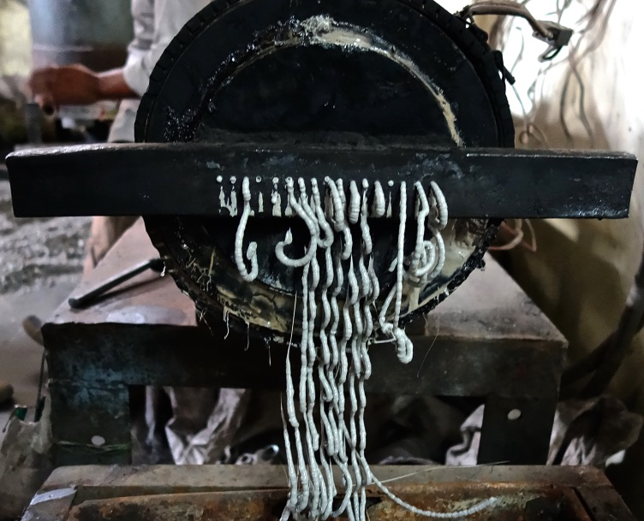
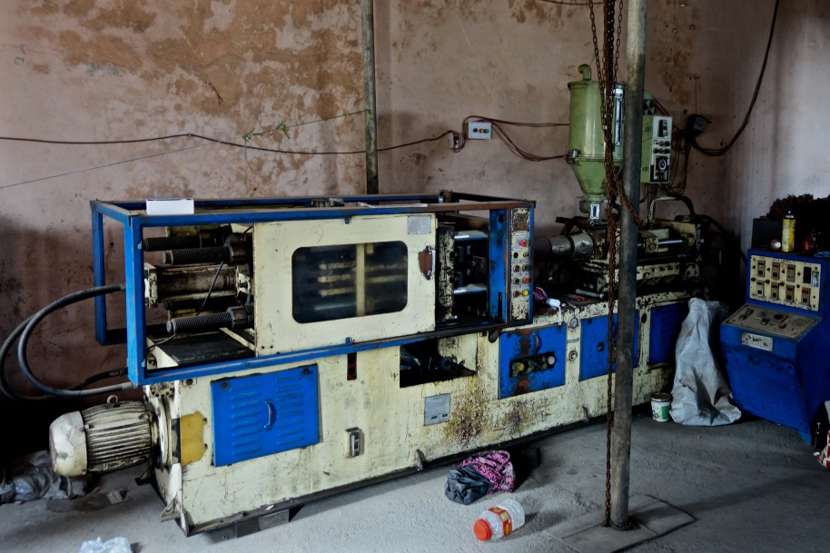
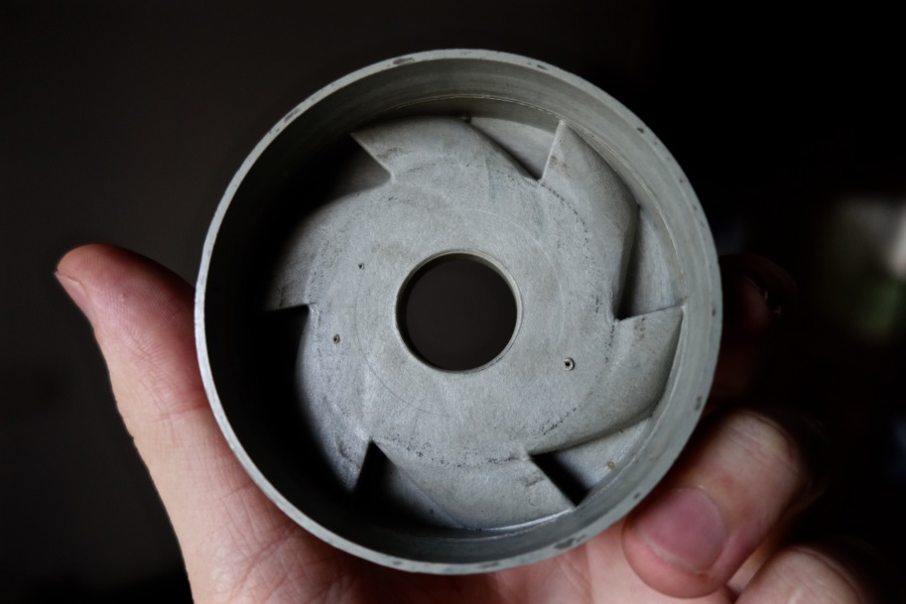
The recycling value chain (3/3)
Extrusion
Manufacture of new products

Slide 13
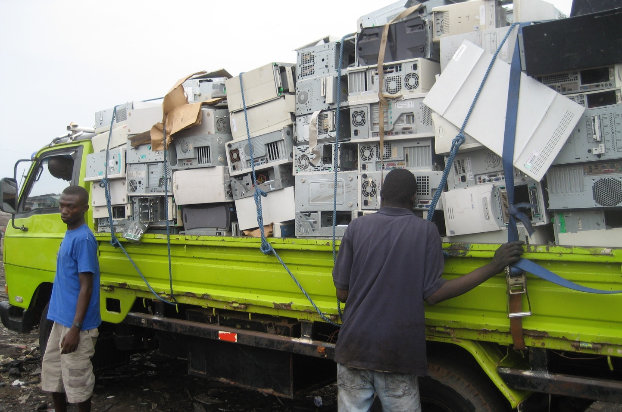
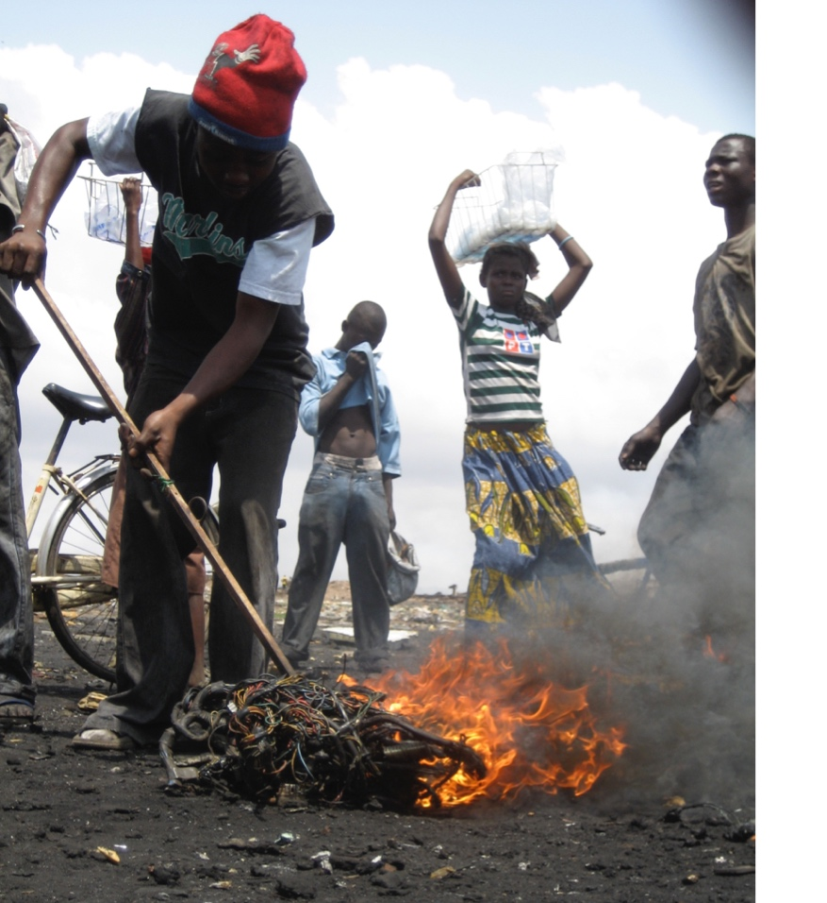
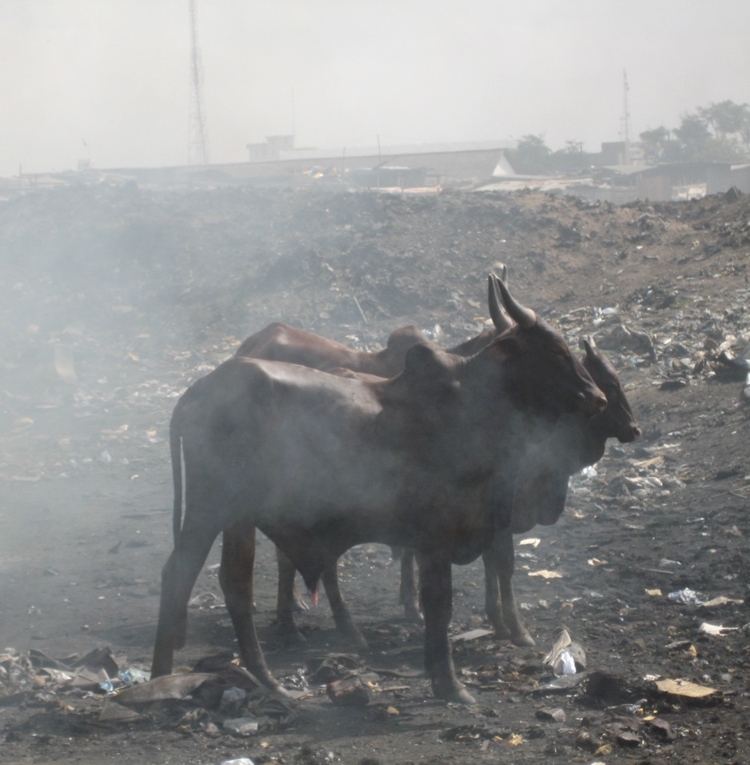
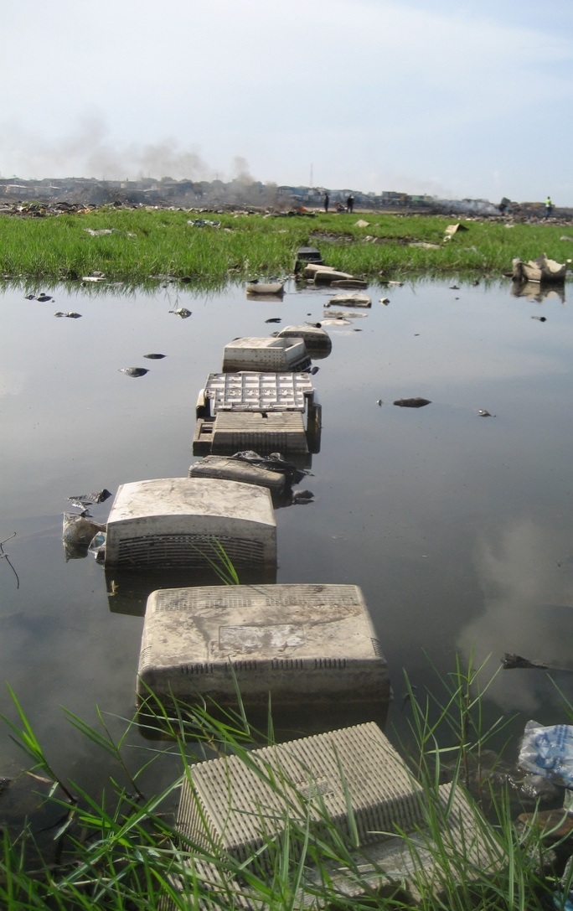
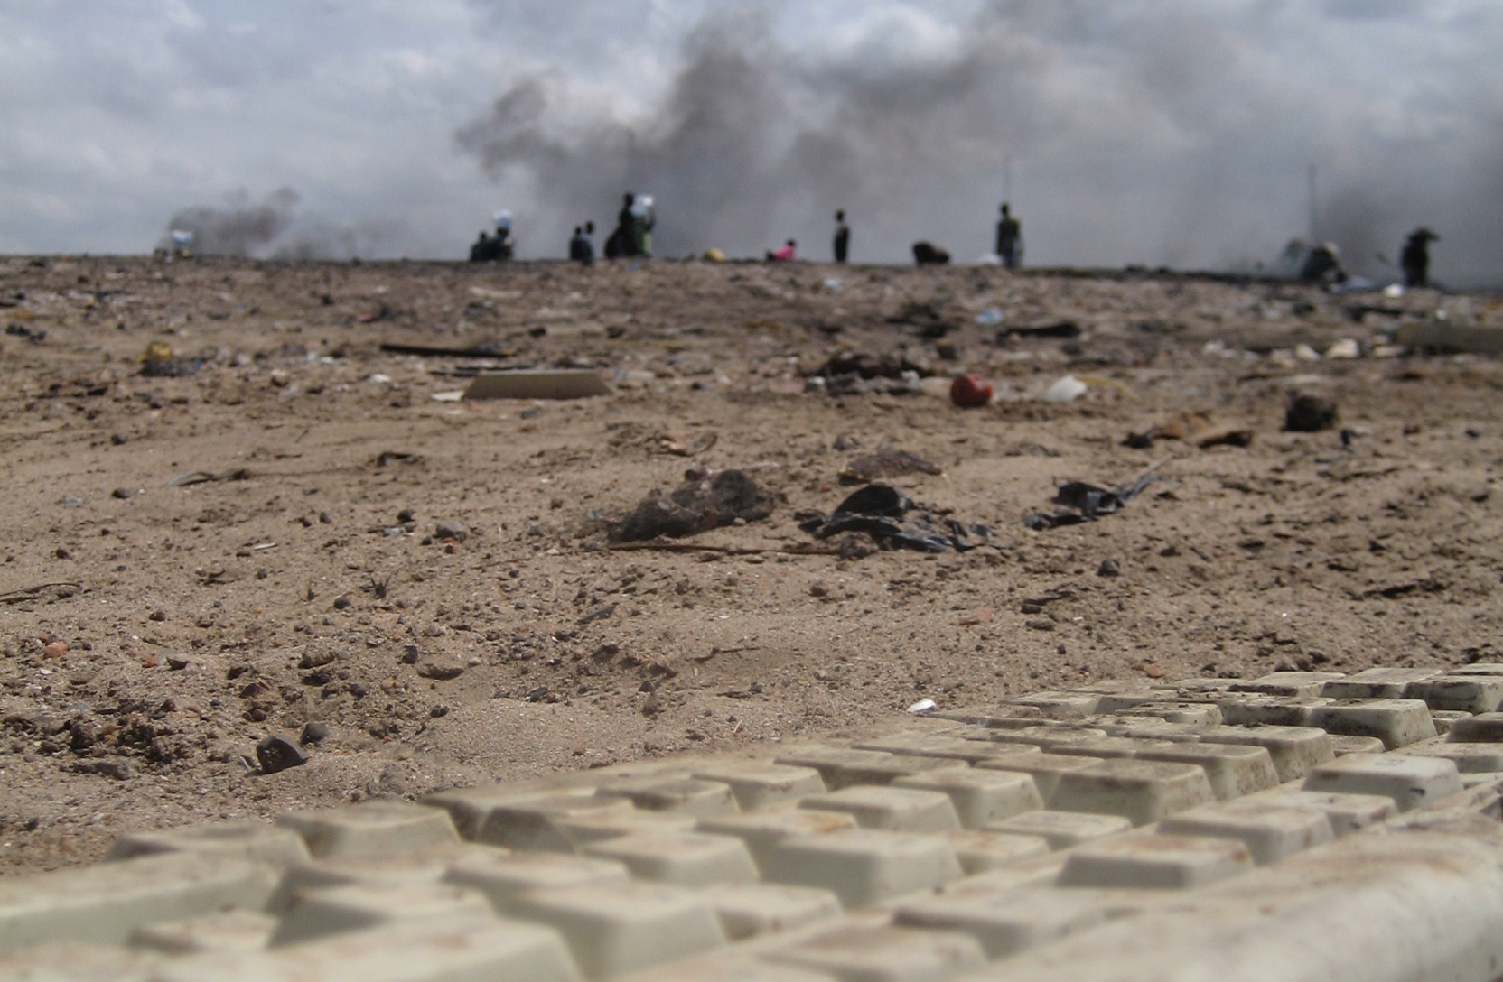
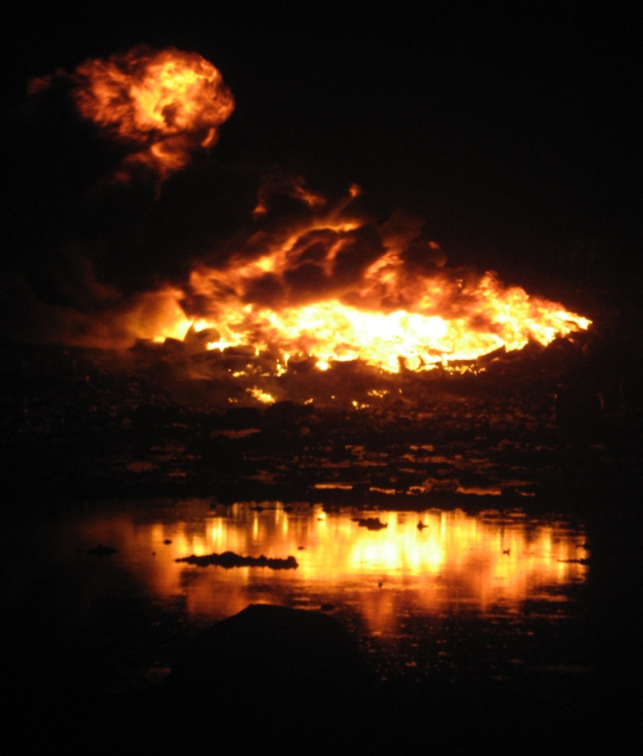
Agbogbloshie Accra – Ghana
Subsistence Activities

Slide 14
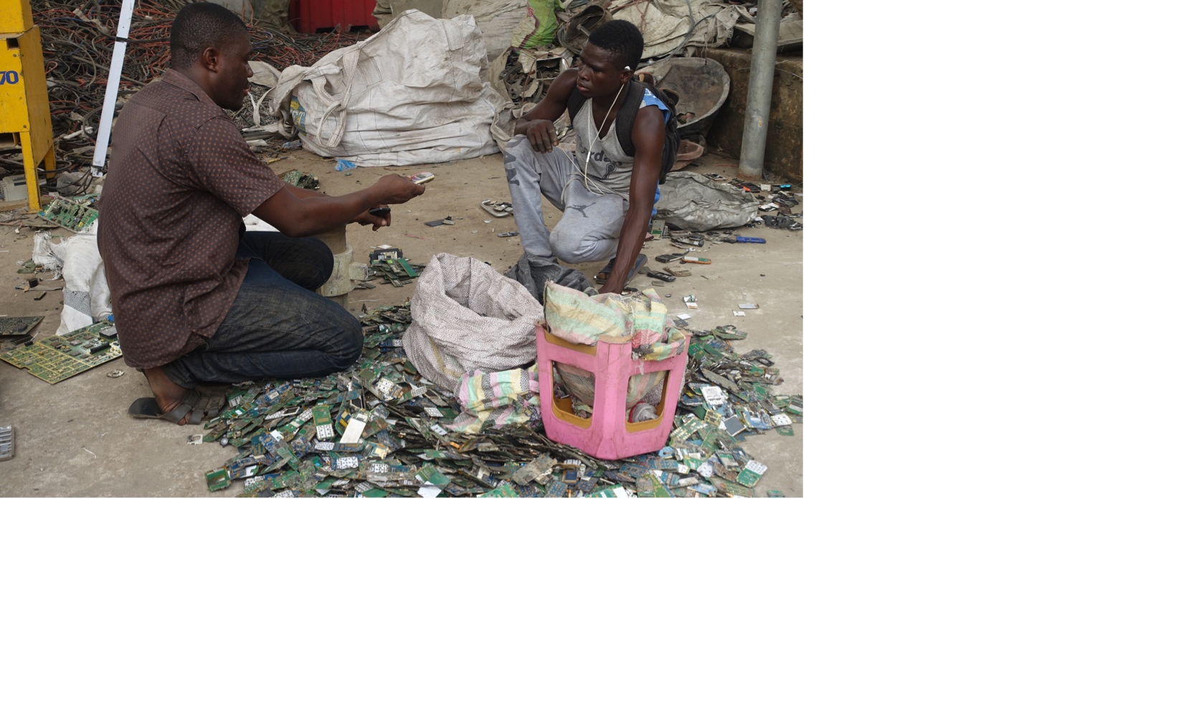
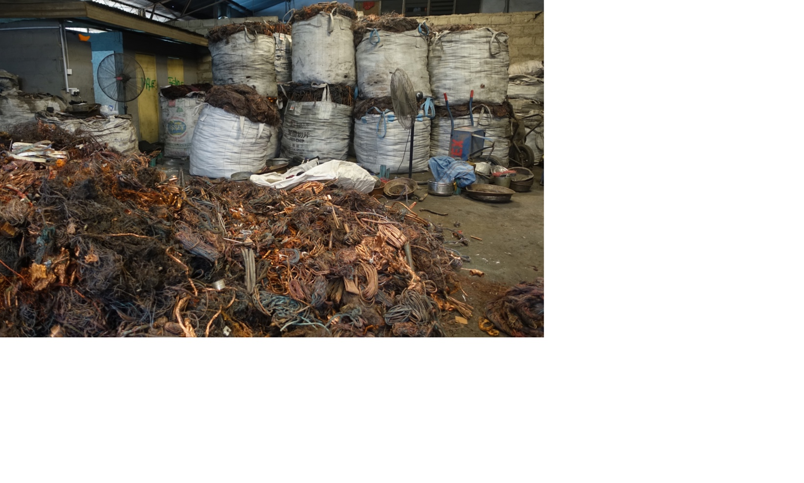
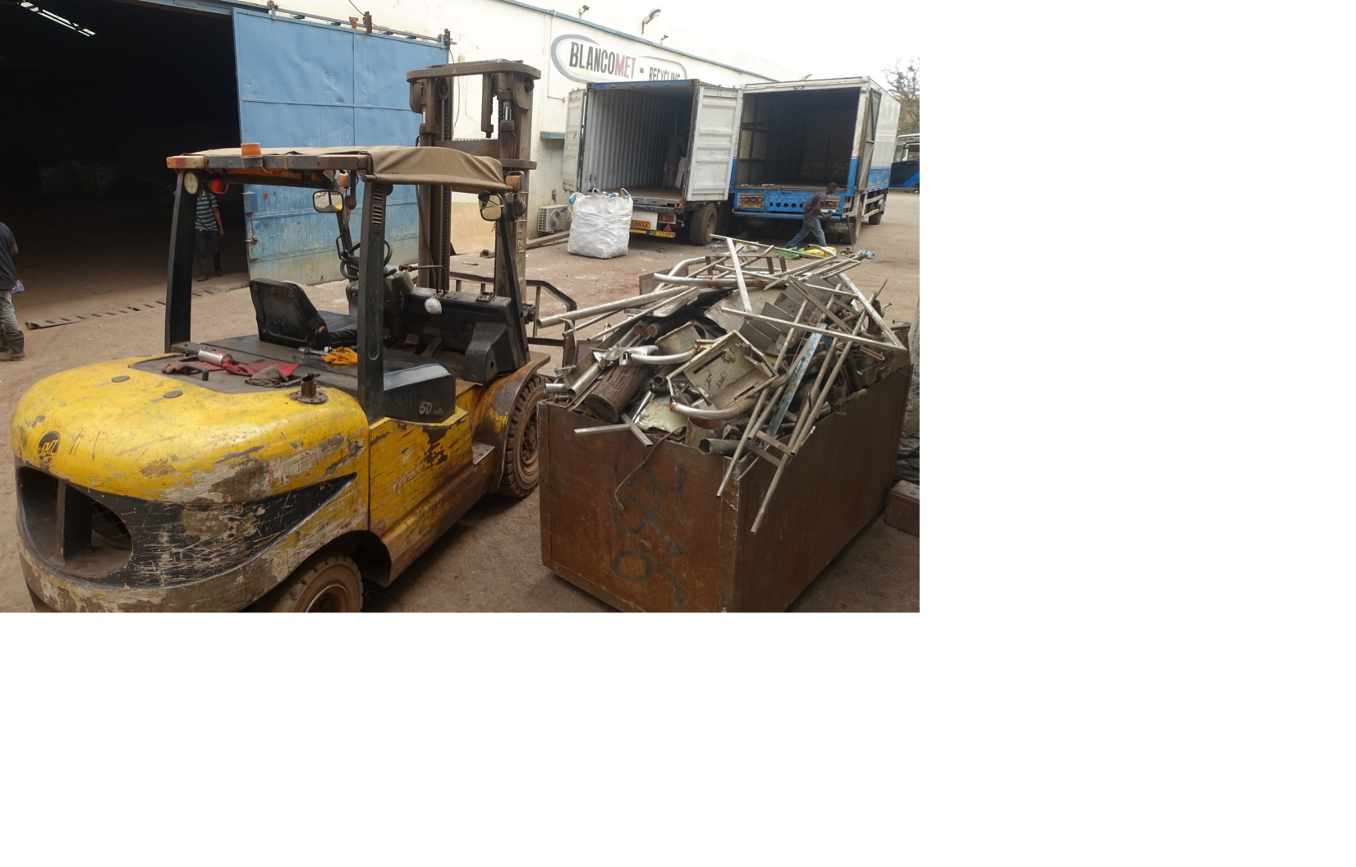
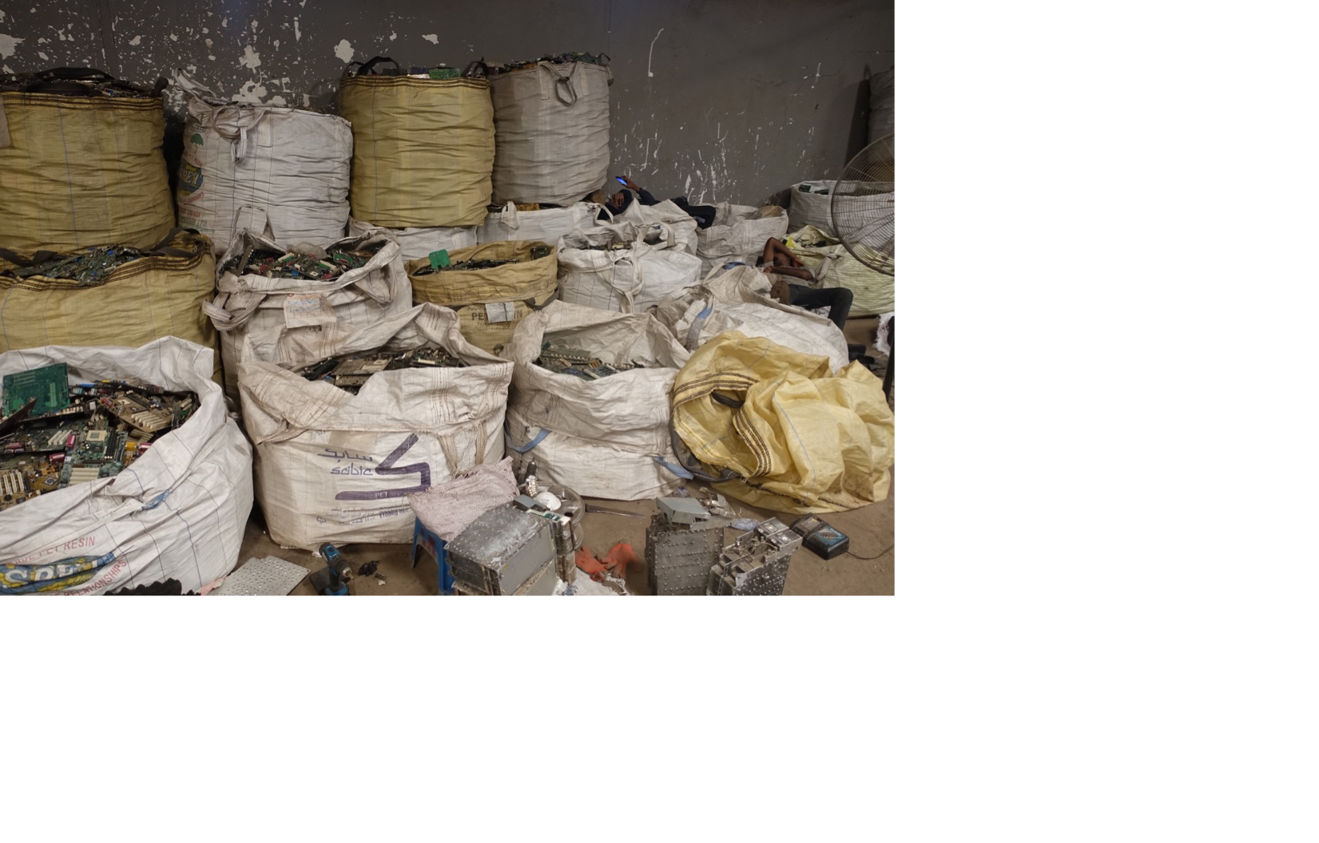
Blancomed Accra – Ghana
“Unofficial” Business Activity

Slide 15
Global Refinery for Secondary Metals
Official Business Activity

Slide 16
The informal recycling sector is not addressed in responsible sourcing schemes
renewable
non-renewable
secondary
Quality and sustainability standards?
?

Slide 17
SRI launched a global multi-stakeholder process to create a framework for inclusive recycling
The new ISO document aims to guide economic operators of secondary metals value chains, including the informal sector, in the efficient and credible implementation of improved recycling practices, in particular in emerging and developing economies.

Slide 18
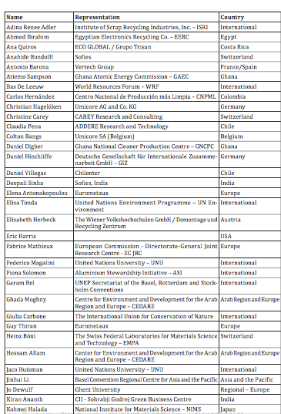
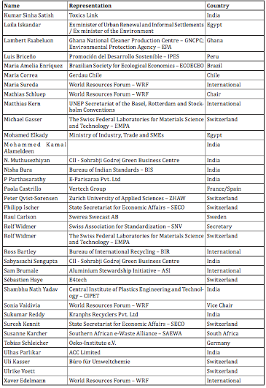
Multi-stakeholder processes are demanding
70
ISO IWA contributors
30
countries represented
15
consultation
events
1500
comments
recieved
1000
interested stakeholders
5
years process from 1st idea to launch
sustainable-recycling.org // sri@wrforum.org

Slide 19
Tales of Trash
5 Principles for Inclusive Recycling
by SRI

Slide 20




The Guidance Principles address five main sustainability requirements for the recycling of secondary metals in developing countries.
1. Enabling safe, healthy and equitable working conditions
2. Building and strengthening local community relations and resilience
3. Conserving and protecting the environment and natural resources
4. Improving recovery of secondary metals
5. Implementing a sustainable management approach

Slide 21
Sustainability requirements
Principle 1
Enabling safe, healthy and equitable
working conditions
Objective 1.1 Enable safe and healthy work places.
Objective 1.2 Establish working terms and conditions that are decent and equitable.
Objective 1.3 Eliminate child labour, forced labour, harassment and all forms of discrimination.
Objective 1.4 Ensure freedom of association and the right to collective bargaining.
Objective 1.5 Provide clear channels for communication, transparency and dialogue with workers.

Slide 22
Traceability requirements: Chain of Custody
Policy and procedures
Responsibilities
Documentation and records
Claims
Physical segregation
Mass balance
Book and claim
CoC Manager
On-product claim (third-party audit)
Off-product claim (second-party audit)

Slide 23
The management plan promotes gradual implementation
Labour issues and Worst Practices resolved
Management plan in place
Year 3
Year 5
Year 1
Formalisation
Year 0
Assurance system
....but requires supporting mechanisms, e.g.,:
-Legal assistance
-Technical training
-Networking
Notes:
S. There are immediate issues to be resolved such as the worst practices and critical impacts on health…we have seen a couple of examples of worst practices in the previous slide.
But changes do not happen in 1 day.
Through the gradual implementation, a reasonable time of 5 years, for example, is provided for economic operators in the informal sector or subsistence activities to resolve other issues such as formalisation and ensure the traceability.
R: “If these huge positive changes happen, of course, that my client will be very interested in working with this value chain. But how can I assure that this is happening?.”

Slide 24

THANK YOU
World Resources Forum Association
Lerchenfeldstrasse 5
9014 St. Gallen
Tel. 071 554 09 00
mathias.schluep@wrforum.org
www.wrforum.org

