Slide 1
Connecting The Unconnected – The Case for GridCode Technology
Being a presentation given at the 25th EACO General Assembly
Held at Bujumbura, Burundi on June 26 , 2023 by Victor Gbadeyan,
Country Director, Akutari Limited (GridCode), Rwanda
eCommerce has come to stay:
Ecommerce is now the dominant force in buying and selling
This became especially evident during the Covid-19 lockdown
Its popularity continues to grow, and we must be prepared for future pandemics
Ecommerce is not just a luxury but a necessity, and we cannot ignore its significance
However, there are key challenges that hinder its mainstream adoption. They are:
Reliable addressing (for last mile delivery)
Teledensity
Internet availability

Slide 2
Connecting The Unconnected – The Case for GridCode Technology
Being a presentation given at the 25th EACO General Assembly
Held at Bujumbura, Burundi on June 26 , 2023 by Victor Gbadeyan,
Country Director, Akutari Limited (GridCode), Rwanda
The Role of Postal Operators
Postal operators play a crucial role in facilitating eCommerce
Addressing is their main KPI… and as stated in the previous slide this is also one of the main challenges they face
Inadequate addressing results in delivery errors, delayed shipments, and inefficiencies in last-mile logistics
Other drawdowns are customer dissatisfaction
And this can lead to a loss of confidence in the entire eCommerce ecosystem with the resulting skepticism in adoption by new participants or rejection altoghether
In order to prevent this unwanted scenario from playing out: AKUTARI Limited have come up with an innovative and smart addressing solution using technology:

Slide 3
Connecting The Unconnected – The Case for GridCode Technology
Being a presentation given at the 25th EACO General Assembly
Held at Bujumbura, Burundi on June 26 , 2023 by Victor Gbadeyan,
Country Director, Akutari Limited (GridCode), Rwanda
It is a mobile application called:
GridCodes

Slide 4
Gridcodes presents a solution that addresses the addressing challenges in the following ways:
a. Simplified Addressing: Gridcodes replaces or supplements traditional addresses with precise grid codes. This simplifies the addressing process for postal operators and courier services, eliminating ambiguity and reducing errors associated with incomplete or incorrect addresses.
b. Efficient Route Planning: With grid codes, postal operators and courier services can optimize route planning and streamline logistics. The standardized digital addresses enable automated systems to calculate the most efficient routes for deliveries, saving time and resources.
c. Last-Mile Delivery Precision: Gridcode Address Digitizer enhances last-mile delivery accuracy. Delivery personnel can navigate directly to the designated grid code location, even in areas with inadequate addressing systems or unconventional addresses. This eliminates the need for guesswork, reducing delivery errors and ensuring prompt and reliable service.

Slide 5
The Benefits are immediate and far-reaching:
Enhanced Operational Efficiency
Cost savings
Expanded service coverage.
Improved customer experience
Speed to market for new products & services
Use Cases & Success Story:
RwadaMart using iPosita On Demand
– The Beginning of an eCommerce Revolution in the Republic of Rwanda

Slide 6
GridCodes
Demo

Slide 7
An Innovative Technology That Answers the Question:
> How Do I Get To An Address? <
FASTER
CHEAPER
EASIER
The answer is DIGITAL.
And we invented an App for it, it’s called:
… digitise your address
www.findgridcode.com

Slide 8
GridCodes®
What is GridCodes Technology?
What does it do?
It is a tool for digital addressing, delivered as a freely downloadable Mobile App
It converts any address into a set of SMART codes that become the DIGITAL address of that location
US Copyright Global
Patent #: TXu 2-153-410
How does it do it?
It synthesises GPS tech, smartphone tech, number sequencing algorithm & the earth’s long/lat coordinate system
www.findgridcode.com

Slide 9
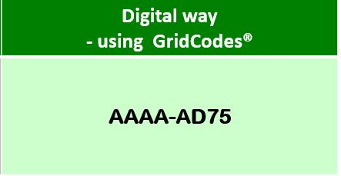
The future of addressing is here >>
Traditional way of locating a place – today’s method | Digital way - using GridCodes®
Locating Aminata’s Restaurant Address description: Aminata’s Lounge, near Kabeza Mall Bar, off Airport Road, by SP Petrol Station Corner, off Remera-Giporoso Junction, Kigali, Rwanda. (It’s the immediate right turn after the junction, it has a black). You can call 0783195787 for further directions | AAAA-AD75
…digitise your address
www.findgridcode.com

Slide 10
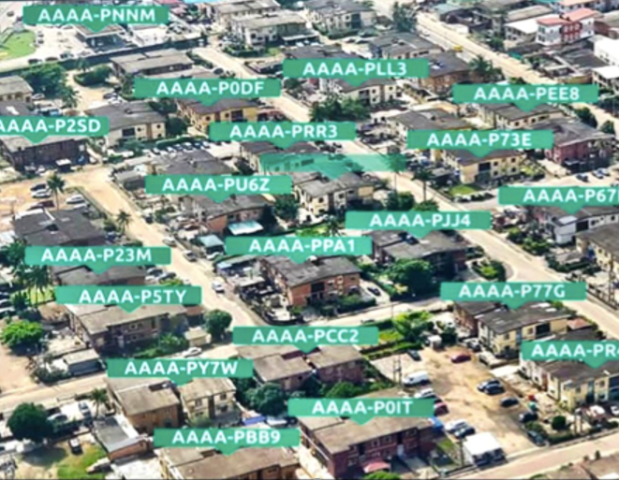

Slide 11
GridCodes
VIDEO INTRO
www.findgridcode.com

Slide 12
> Practical Demo <
(a 3-minute practical demonstration of the power of GridCodes)
www.findgridcode.com

Slide 13
Some real-life applications of this innovative technology:
Last mile delivery of mails & courier
eCommerce & home delivery service
Property addressing & urban development
Security & emergency services / first responders
Drone delivery service & operations
Smart cities development and administration
Is currently deployed in Nigeria & Rwanda.
Ready to partner with all of the EA community
to achieve smart addressing & digitization goals
in line with UPU standards
www.ipositaondemand.rw
www.findgridcode.com

Slide 14
… digitise your address
Thank you for your time!
> Q & A <
www.findgridcode.com

