Slide 1
ITU Digital Financial Services Security Recommendations
Arnold Kibuuka
Project Officer
Standardization Bureau, ITU
Notes:
1

Slide 2
Overview
DFS Security Recommendations
DFS Security Lab
Other Actions being implemented
    ITU Cyber Security Resilience Assessment toolkit for DFS Critical Infrastructures
    ITU Knowledge Sharing Platform for Digital Finance Security

Slide 3
1. ITU DFS Security Recommendations
The recommendations contain the following specific guidelines that may be adopted by regulators.
Recommendations to mitigate SS7 vulnerabilities
Model Memorandum of Understanding between a Telecommunications Regulator and a Central Bank Related to Security for Digital Financial Services
Recommendations for securing mobile payment apps
Recommendations for operators and regulators for SIM card risks such as SIM swap fraud and SIM card recycling
DFS Consumer Competency Framework

Slide 4
2. ITU DFS Security Lab
  Provides a standard methodology to conduct security audit for mobile payment apps (USSD, Android and iOS) and address systemic vulnerabilities and verify compliance against security best practices and standards.
Website: https://figi.itu.int/figi-resources/dfs-security-lab/
Notes:
The DFS Security Lab addresses the issue that DFS regulators are unable to verify the security of mobile payments apps in use in their jurisdiction and as such cannot provide the assurance to consumers that these apps are safe and secure. The Security Lab aims to provide to DFS regulators a standard methodology to conduct security audit for mobile payment apps (USSD, Android and iOS) and address systemic vulnerabilities and verify compliance against security best practices and standards.
The DFS Security Lab software are mainly open source software for carrying out the security tests and is done in this way, to illustrate that it would be easy for hackers to do same.

Slide 5

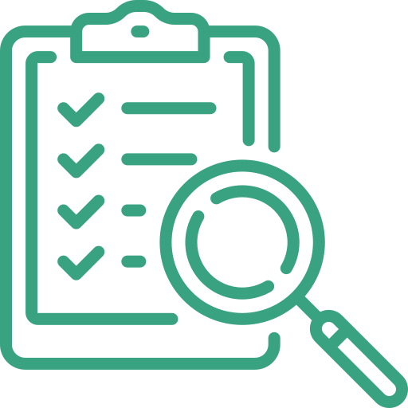




DFS Security Lab - Objectives
Collaborate with regulators to adopt DFS security recommendations from FIGI
Perform security audits of mobile payment apps (USSD, Android and iOS)
Encourage adoption of international standards on DFS security and participate in ITU-T SG17
Organise security clinics & Knowledge transfer for Security Lab
Assist regulators to evaluate the cyberresilience of DFS critical infrastructure
Networking platform for regulators for knowledge sharing on threats and vulnerabilities
Notes:
The main objectives of the DFS Security Lab are to
Collaborate with regulators to adopt DFS security recommendations from FIGI. These security recommendations include technical standards and best practices for securing the telecommunications infrastructure, process for cybersecurity risk management for DFS and technical guidelines for securing mobile payment applications.
Perform security audits of mobile payment apps (USSD, Android and iOS)
Encourage adoption of international standards on DFS security
Organise security clinics & Knowledge transfer for Security Lab
Assist regulators to evaluate the cyberresilience of DFS critical infrastructure
Networking platform for regulators for knowledge sharing on threats and vulnerabilities
The last two objectives in red are not functional yet and will be implemented in 2023.

Slide 6
3. Actions being implemented
DFS Security clinics with a focus on knowledge sharing on DFS security recommendations from FIGI
Knowledge transfers for regulators of Tanzania, Uganda, The Gambia to set up DFS Security Lab
Guidance on implementing recommendations DFS security recommendations
Security audits of mobile payment applications and SIM cards (Zambia, Zimbabwe, The Gambia, Tanzania, Uganda).
ITU Knowledge Sharing Platform for Digital Finance Security
ITU Cyber Security Resilience Assessment toolkit for DFS Critical Infrastructure
Notes:
Actions implemented in 2021 and 2022 include:
Organisation of DFS Security clinics in some 18 countries with a focus on knowledge sharing on DFS security recommendations from FIGI
Knowledge transfer for regulators of Tanzania, Uganda and Peru to set up DFS Security Lab
Guidance on implementing recommendations DFS security recommendations
Conduct security audits of mobile payment applications and SIM cards (Zambia, Zimbabwe, The Gambia, Peru, Tanzania and Uganda).

Slide 7
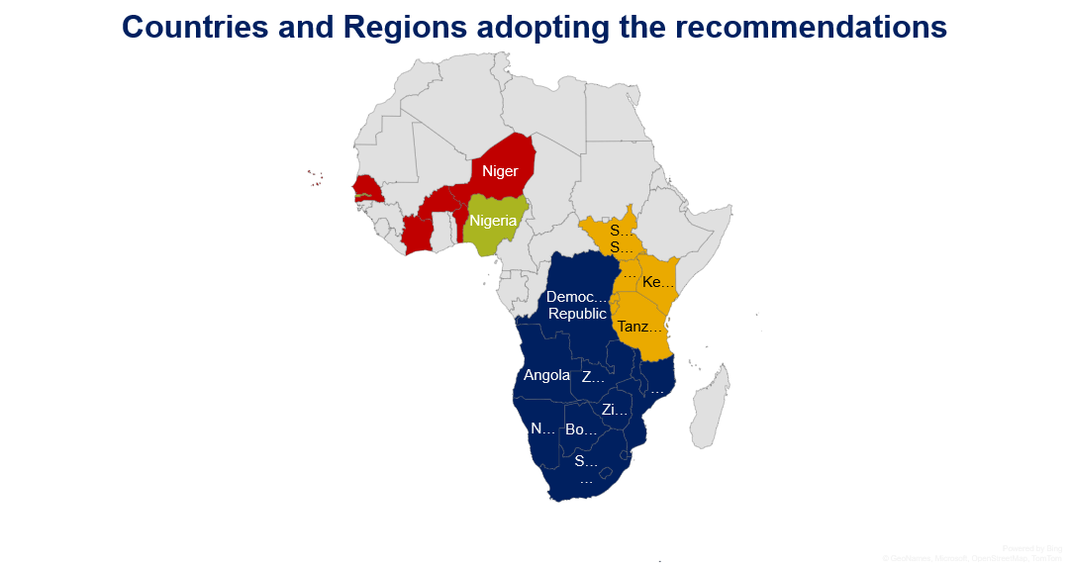
 | Adopted at a regional level by CRASA
 | Considered for adoption at EACO regional level
 | Country level adoption
 | Under consideration - WATRA
Notes:
The Security recommendations for DFS have been adopted in several countries in Africa (those in East Africa, members of CRASA, EACO and Nigeria), Latin America (Peru) and Asia (Pakistan).

Slide 8
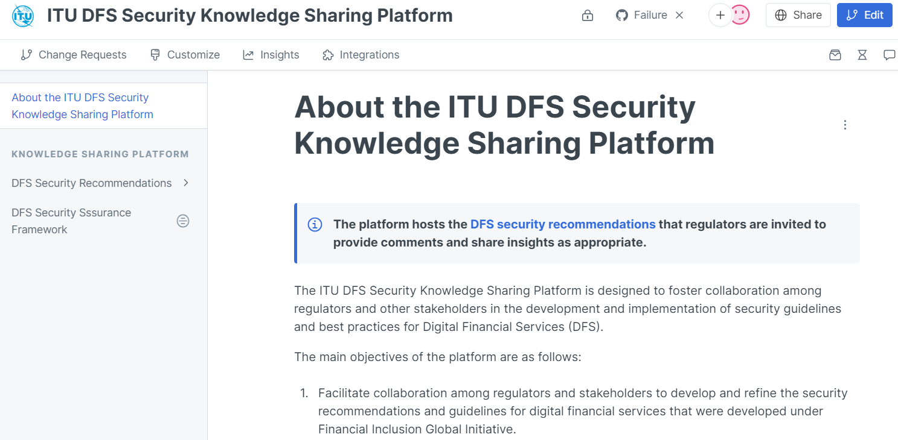
About the ITU DFS Security Knowledge Sharing Platform - ITU DFS Security Knowledge Sharing Platform (gitbook.io)

Slide 9
Cyber Security Resilience Assessment toolkit for DFS Critical Infrastructures
Objectives
Facilitate Cyber Resilience Self-Assessments: To empower DFS entities, users, and actors to proactively assess their existing security protocols and identify potential vulnerabilities.
Enhance DFS Infrastructure Resiliency: Reinforce both peripheral and internal defences of the DFS infrastructure, bolstering resistance against potential cyber threats.
Provide Stakeholder Education: Equip stakeholders from various sectors within the DFS ecosystem, including telecommunications and finance, with the knowledge to prepare for and defend against malicious cyber operations and unauthorized access attempts.
Establish Best Practices: Encourage the adoption and implementation of effective cyber defence practices tailored to each DFS entity's unique needs

Slide 10
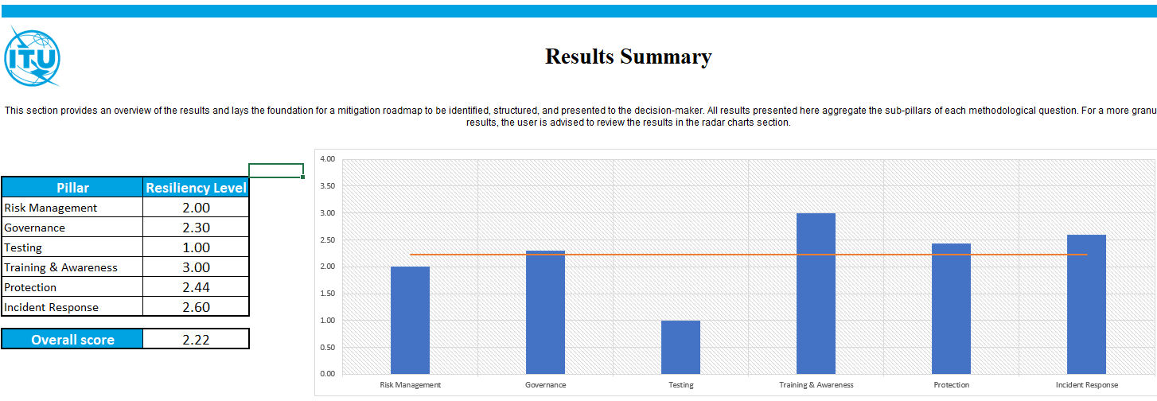
Results assessment summary: Cyber Security Resilience Assessment toolkit

Slide 11


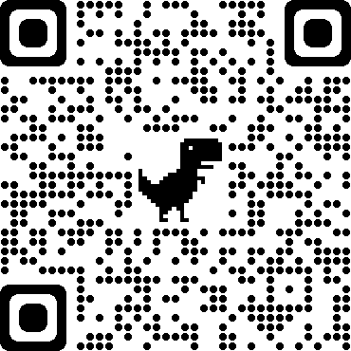
ITU DFS Security Lab
Get in touch
dfssecuritylab@itu.int
https://figi.itu.int/figi-resources/dfs-security-lab/

