Slide 1
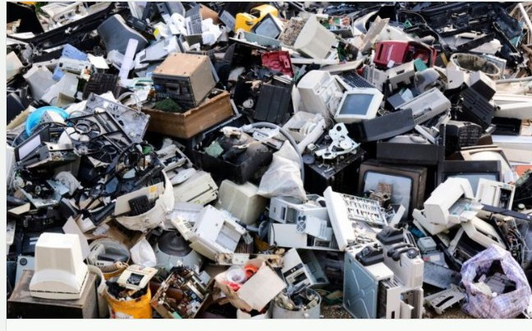

E-waste Survey Report
Juba-South Sudan
Nov-2023
Eng. Philip Apiu Majok
Assistant Director for Spectrum Monitoring & Planning
National Communication Authority-NCA

Slide 2
E-waste Survey Report
Objectives of the Survey:
To Identify main sources of e-waste in Juba-South Sudan, such as households, businesses, and government institutions
To assess the current management practices of e-waste
Raise awareness about the hazards of e-waste in order to serve as a platform to raise public awareness about the harmful effects of e-waste on health and the environment
To establish a baseline for tracking progress in e-waste management efforts over time
To provide adequate recommendations on e-waste practices
To prepare a draft guidelines on e-waste management
To facilitate collection process and assembly points

Slide 3
Regional Data
Source: Estimate from Global E-waste Monitor 2020
www.itu.int

Slide 4
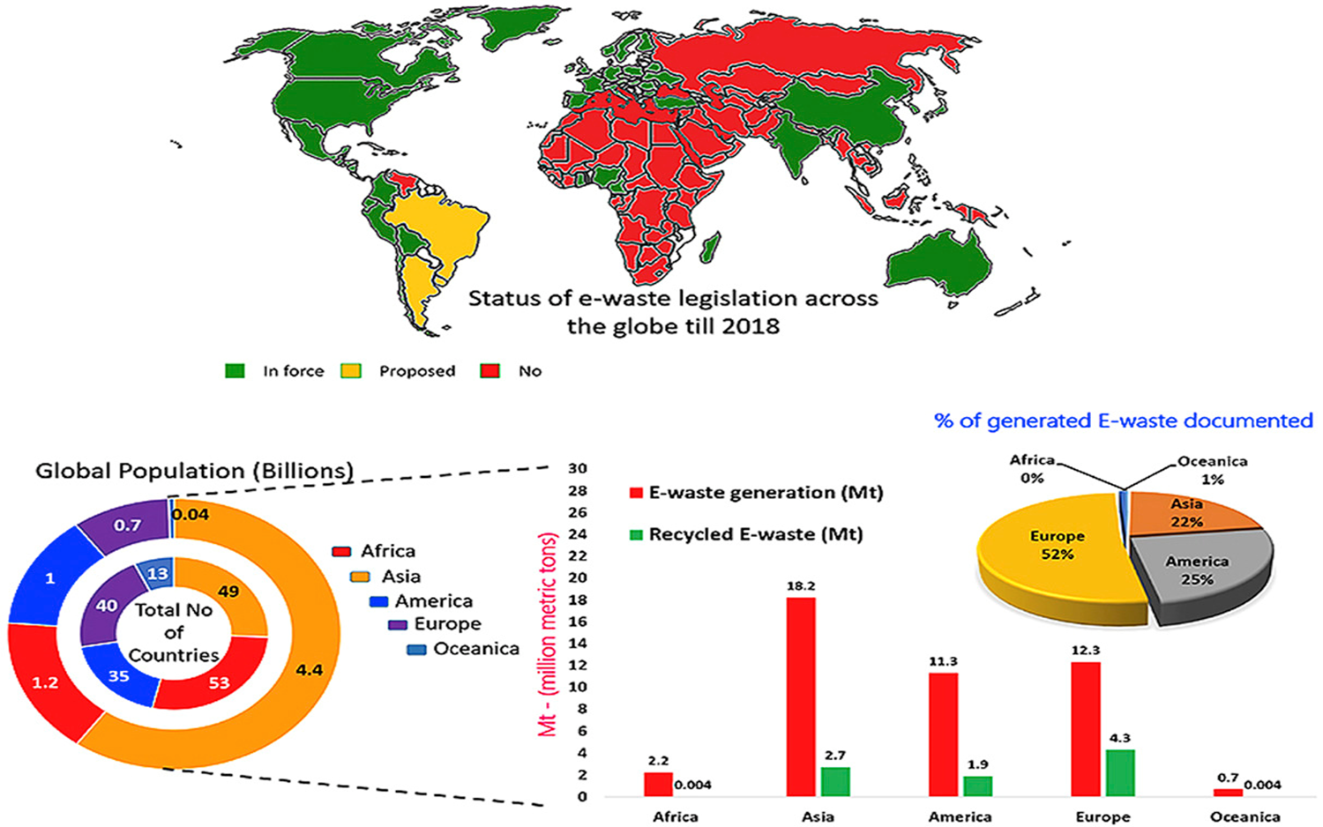
Global E-waste Statistics
Source: Global E-waste Management (https://globalewaste.org/map/)

Slide 5
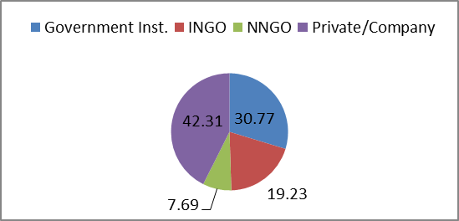
E-waste Survey Report-Juba
Fig 1: Key Respondents
Source: National Communication Authority (NCA), 2023

Slide 6
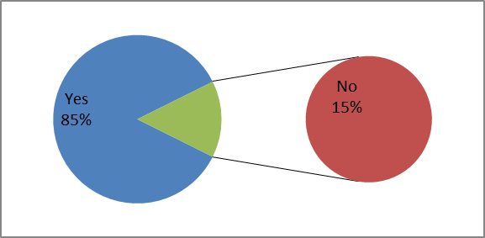
Fig 2: E-waste available for disposal
Do you have electronic-waste for disposal?

Slide 7
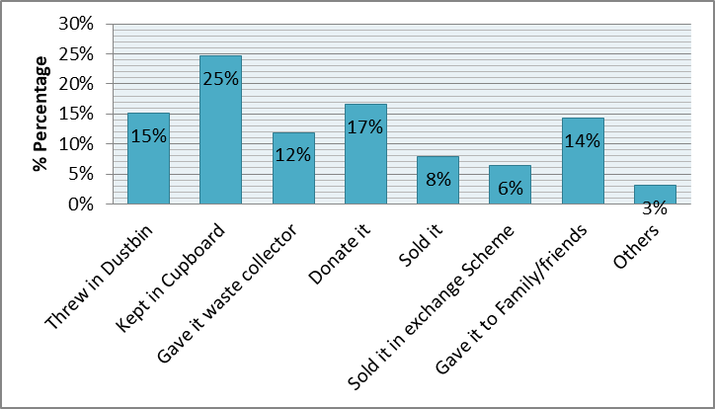
Figure 3: Disposal Options
Institutional Management of E-waste
Source: National Communication Authority, 2023

Slide 8
Figure 4: E-waste Collector
Have you ever heard of e-waste collector in South Sudan?

Slide 9
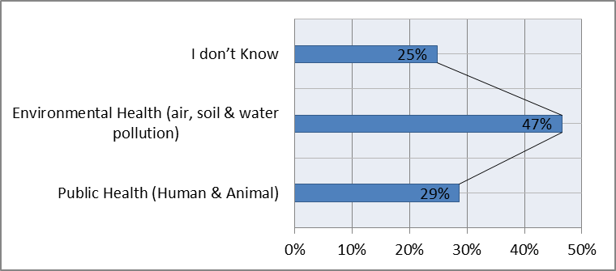
Figure 5: Understanding of Risks.
What Happen to E-waste if not collected, disposed-off and recycled properly?
Source: National Communication Authority (NCA, 2023)

Slide 10
Figure 6: Recycling Preferences
How would you prefer to recycle E-waste?
Source: National Communication Authority (NCA), 2023

Slide 11
Figure 7: Understanding of E-waste Impacts
Importance of keeping E-waste out of Landfills
Source: National Communication Authority (NCA), 2023

Slide 12
Key Findings
85% of the respondents confirmed different categories of e-waste are available in their offices ready to be disposed-off
The institutions surveyed said they kept their e-waste in cupboards and sometimes donated it to a third party for recycling (informal group are involved or unauthorized).
The institutions interviewed confirmed that improper management of e-waste posed a greater risk to public health and environmental hazards such as air, water, and soil pollution
Respondents indicated that they would prefer the National Communication Authority (NCA) and authorized partners to collect e-waste for proper disposal and recycling

Slide 13
Recommendations
National Communication Authority (NCA) to develop guidelines on e-waste management policy to facilitate collection, recycling and disposal
NCA and partners to conduct campaigns and education programs to increase awareness about the environmental and health risks of improper e-waste disposal .
Initiate a assembly point for e-waste disposal. This will allow the general public to dispose-off obsolete e-waste at a designated location
A private-public partnership (PPT) to facilitate proper collection and disposal of e-waste in Juba and across the country (South Sudan

Slide 14
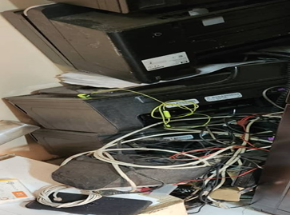
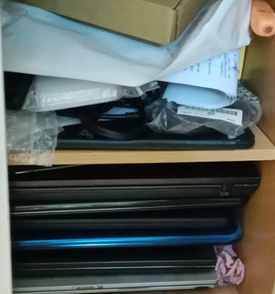
Obsolete E-waste

Slide 15
National Communication Authority-NCA
Follow us @:
E-mail: ewaste@nca.gov.ss || info@nca.gov.ss
Facebook: National Communication Authority
www.nca.gov.ss
Eng. Philip Apiu
Assistant Director of Spectrum
E-mail:papiu@nca.gov.ss/philipapiu@gmail.com
Cell: +211926105483/0913449002

Slide 16
National Communication Authority (NCA)
Thank for Listening !!

