Slide 1
Addressing e-waste from a criminal justice perspective Space Colin Craig, Associate Legal Officer 6th EACO Regional E-Waste Workshop on Sustainable E-Waste Management in the East African Region, 12 March 2024
Notes:
Thank you to EACO for the opportunity to present at this workshop on behalf of UNODC
My presentation this morning will cover:
UNODC’s work on waste crime
The role of criminal law in addressing e-waste
UNODC’s Legislative Guide on Waste Trafficking

Slide 2
Kyoto Declaration at 14th Crime Congress
We therefore endeavour to take the following actions: […]
87. Adopt effective measures to prevent and combat crimes that affect the environment, such as illicit trafficking […] in hazardous wastes and other wastes […] by making the best possible use of relevant international instruments and by strengthening legislation, international cooperation, capacity-building, criminal justice responses and law enforcement efforts […]

Slide 3
Basel Convention
Article 4(3): “The Parties consider that illegal traffic in hazardous wastes or other wastes is criminal.”
Article 9(5): “Each Party shall introduce appropriate national/domestic legislation to prevent and punish illegal traffic. The Parties shall co-operate with a view to achieving the objects of this Article.”
Similar statements in Bamako Convention of the African Union
Notes:
Article 4(1) of the Bamako Convention: “All Parties shall take appropriate legal, administrative and other measures within the area under their jurisdiction to prohibit the import of all hazardous wastes, for any reason, into Africa from non-Contracting Parties. Such import shall be deemed illegal and a criminal act.”
Article 9(2) of the Bamako Convention “Each Party shall introduce appropriate national legislation for imposing criminal penalties on all persons who have planned, committed, or assisted in such illegal imports. Such penalties shall be sufﬁciently high to both punish and deter such conduct.”

Slide 4
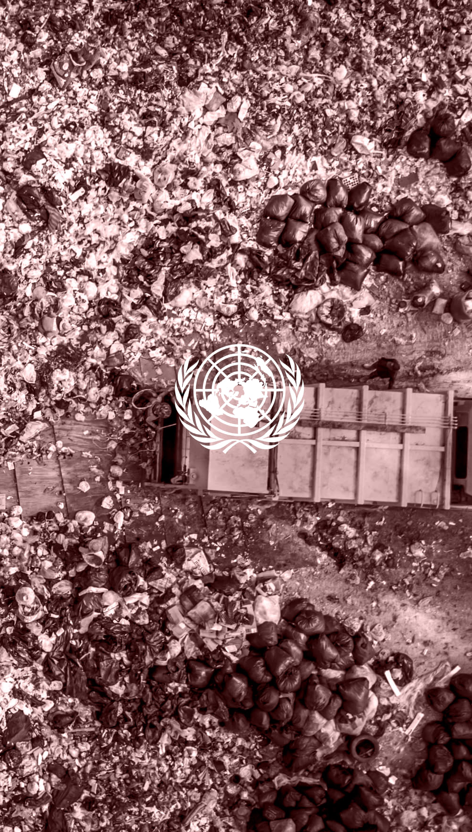
UNODC’s work on waste crime
Addressed through programmes focused on:
Crimes that affect the environment
Passengers and cargo
Maritime crime
Criminal network disruption
Organized crime
Corruption
Money laundering
Research and trend analysis
Addressing waste trafficking between EU and Southeast Asia (Unwaste)
Notes:
1. Environment
Global Programme on Crimes that Affect the Environment (GPCAE)
Capacity building for national investigators, prosecutors and judges
Strengthening national and international cooperation
Awareness raising and knowledge sharing
Coordinates internally within UNODC and with other agencies
2. Passengers and cargo
Passengers and Cargo Border Team (PCBT)
Merger of two global programmes in the Border Management Branch (BMB):
Container Control Programme (CCP)
Airport Communication Programme (AIRCOP)
Works with States to address trafficking of hazardous waste through maritime shipping containers and movement of cargo through airports
Capacity building for customs and other frontline officers
3. Maritime crime
Global Maritime Crime Programme (GMCP)
Works on ship-source pollution, marine waste disposal and waste trafficking by sea
Supports harmonized SOPs for waste trafficking with coastal and flag States
Enhances detection capacity
Trains coast guard officers
Works to strengthen international cooperation regarding shipments by sea
4. Criminal network disruption
Global Programme on Criminal Disruption (GPCD)
Operational analysis to understand the structure, modus operandi, finances and trafficking routes of OCGs involved in trafficking of waste
Systems analysis and disruption training to law enforcement and prosecutors regarding waste trafficking
5. Organized crime
Global Programme on Implementing the Organized Crime Convention
Tools development
Waste guide, pollution guide coming
Legislative assistance
Knowledge management
SHERLOC
6. Corruption
Corruption and Economic Crime Branch (CEB)
Secretariat to COSP of UNCAC
Facilitates corruption risk management processes within institutions involved in waste management
Facilitates collaboration and information exchange between anti-corruption and waste management authorities
Capacity building on anti-corruption for waste management authorities
Development of knowledge products
7. Money laundering
Global Programme against Money Laundering, Proceeds of Crime and Financing of Terrorism (GPML)
Legislative development and policy support
Capacity building
Regional and international cooperation
Raising awareness and knowledge sharing
Addressing interlinkages with other criminal activities
8. Research and trend analysis
Research and Trend Analysis Branch (RAB)
Recently embarked on a Global Analysis on Crimes that Affect the Environment, including waste crime
9. Addressing waste trafficking between EU and SE Asia
Unwaste (under ROSEAP)
Project objectives:
Better understand waste flows between Europe and Southeast Asia
Promote cooperation through national dialogues
Facilitate intra- and inter-regional dialogues at the policy level to promote partnership between EU and SEA countries

Slide 5
Role of criminal law in addressing (e-)waste
Criminal justice approaches are an important element of holistic policy responses
Acknowledgement of involvement of organized criminal groups
Sanctions that reflect the seriousness of waste crime and provide general and specific deterrence
Measures targeting profitability of waste crime
Seizure and confiscation; criminalization of money laundering
Criminal justice approaches still need to be seen in the broader context of waste management regulation
Preventing, not just combating

Slide 6
Role of criminal law in addressing (e-)waste
Criminal law provisions are closely related to waste management legislation
Provide teeth to regulatory frameworks
Criminal law reliant on waste management legislation to delineate what is a crime – relevance of permits, licences, authorizations

Slide 7
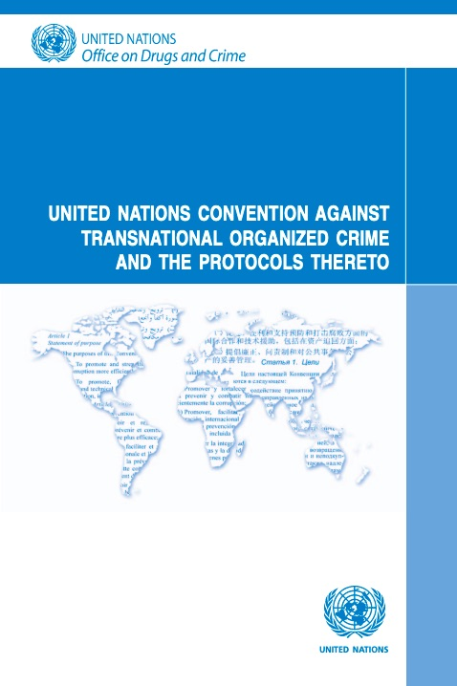
United Nations Convention against Transnational Organized Crime
192 Parties to the Convention
Adopted: 15 November 2000
Entered into force: 29 September 2003
Purpose (article 1):
“ to promote cooperation to prevent and combat transnational organized crime more effectively”
Notes:
Before looking at what’s included in the Legislative Guide on sanctions more closely, I wanted to briefly introduce the Organized Crime Convention as the context for our Legislative Guide

Slide 8
Overview of provisions of the Convention
Criminalization and criminal liability
e.g. four offence provisions, liability of legal persons
Investigation
e.g. confiscation and seizure, special investigative techniques
International cooperation
e.g. law enforcement cooperation, mutual legal assistance, extradition
Protection of and assistance to witnesses and victims
Prevention

Slide 9
Legislative Guide on Waste Trafficking
8 chapters
29 model legislative provisions
28 legislative examples
+ new Legislative Guide on Pollution Crime in development (publication mid-2024)
Notes:
Legislative examples come from around the world, representing different regions and legal systems

Slide 10
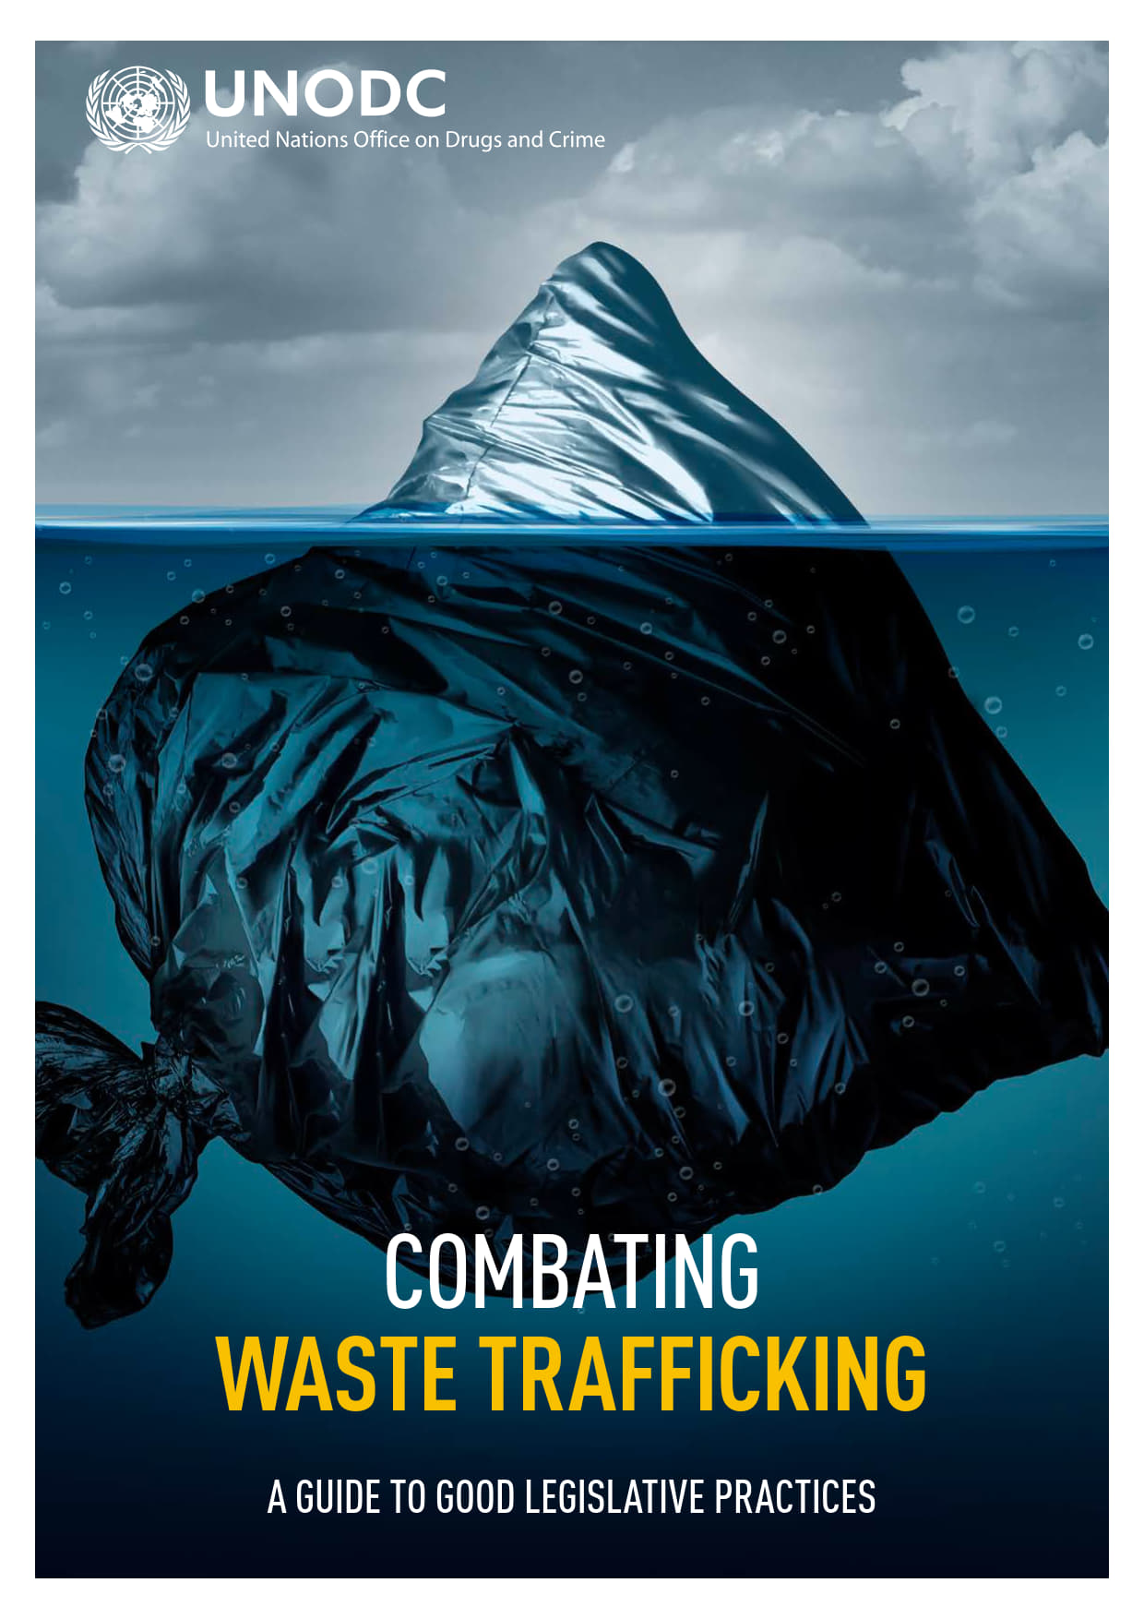
Legislative Guide on Waste Trafficking
Chapter 1: General considerations
International legal framework, domestic waste management legislation, national institutional framework
Chapter 2: General provisions
Statement of principles of environmental law, definitions, jurisdiction, waste schedules

Slide 11
Legislative Guide on Waste Trafficking
Chapter 3: Offences and liability
Elements of criminal offences
Waste offences
Waste trafficking, document fraud in connection with waste management
Ancillary offences
Conspiracy and criminal association, money-laundering, corruption, obstruction of justice
Secondary liability, liability for attempts
Liability of legal persons
Including due diligence obligations, challenges to establishing liability
Defences

Slide 12
Legislative Guide on Waste Trafficking
Chapter 4: Investigation
General and special investigative techniques, seizure and confiscation, evidential considerations
Chapter 5: International cooperation
Mutual legal assistance (MLA), law enforcement cooperation, extradition, joint investigations

Slide 13
Legislative Guide on Waste Trafficking
Chapter 6: Prosecution and penalties
Prosecutorial discretion, pre-trial detention, alternatives to trial, limitation periods
Considerations underlying sentencing, types of sanctions, sanctions for legal persons
Chapter 7: Protection and assistance
For witnesses, victims, persons cooperating with authorities
Chapter 8: National coordination

Slide 14
Access the legislative guide
Visit sherloc.unodc.org or scan the QR code:
Thank you

