Slide 2
Introduction - Kenya’s waste management
Kenya’s waste management sector
Global importance of sustainable waste management

Slide 3
Understanding EPR
Definition and concept

Slide 4
The SWM Act 2022 defines EPR as environmental management approach in which a producer‘s responsibility for a product is extended to the post- consumer stage of a product life cycle; “hazardous waste” has the meaning assigned to it under the Environmental Management and Co-ordination ​
→ In effect, the financial responsibility of waste management for end-of-life products, including the collection, transportation, treatment, and recycling, is shifted to the producer. ​
→ EPR encourages producers to design products that are easier to recycle and that reduce waste generation.

Slide 5
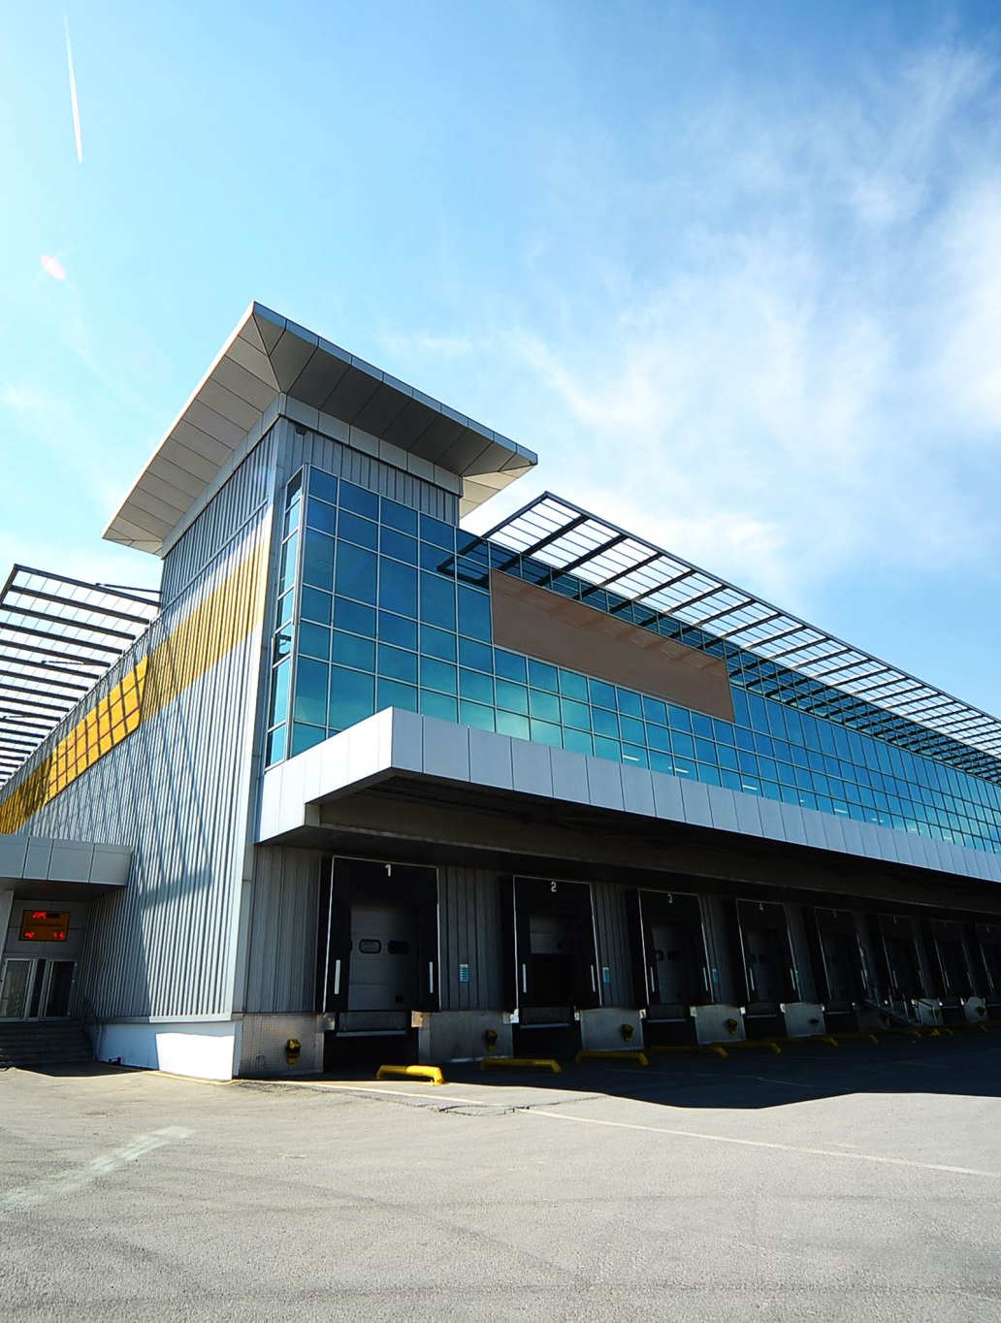
The EPR stakeholders
Primary EPR stakeholders:​
Producers, Importers, Brand Owners (PIBOs)​
Government Authorities​
Consumers​
Waste Operators​
Recyclers​
PRO(s)​
Secondary Stakeholders:​
Environmental NGOs​
Industry Associations​
Local Communities & the Environment​

Slide 6
Success factors of EPR
Set smart targets​
Define clear roles and responsibilities​
Ensure a level playing field​
Empower and educate consumers​
Set simple and equitable rules​
Ensure effective enforcement​
Promote research and development​

Slide 7
Kenya's EPR Landscape
Current regulations and policies
Role of the private sector and existing collaborations
Achievements, gaps, and opportunities

Slide 8
EPR REGULATIONS IN KENYA​
Section 13 of the sustainable waste management act 2022 introduces Extended Producer Responsibility: ​
(1)Every producer shall bear extended producer responsibility obligations to reduce pollution and environmental impacts of the products they introduce into the Kenyan market and waste arising there from ​
(2) Every producer shall fulfill their extended producer responsibility obligations individually or collectively in a compliance scheme. ​
(3) The Cabinet Secretary shall, within two years of the coming into operation of this Act make regulations on extended producer responsibility.

Slide 9
Cont’
Part II of the Sustainable Waste Management (Extended Producer Responsibility) Regulations, 2023, mandates certain responsibilities for producers under section 13 of the Act. ​
Producers must establish take-back schemes which may include deposit refund system when appropriate, and either set up or join individual or collective EPR compliance schemes. ​
They are required to register with NEMA and regularly report on the status of their obligations' implementation. ​
The regulations also stress the importance of designing environmentally friendly products and packaging that minimise waste and facilitate reuse and recycling. ​
Producers should take financial, organisational, and physical responsibility for managing, treating, and disposing of their post-consumer products and waste generated by their products.

Slide 10
Cont’
Producers are further instructed to provide consumers with updated information regarding the quantities of products they introduce into the national market, their recyclability, reusability, interpretation of packaging labels, and market traceability mechanisms. ​
They must educate consumers about their roles in reuse, return, and take back schemes and the meanings of recycling and recovery labels and symbols on products. ​
Producers are also expected to promote awareness about managing post-consumer products they introduce into the market and carry out product lifecycle assessments to enhance environmental sustainability.​
A producer may execute all or part of their extended responsibility obligations through a membership agreement to a collective scheme managed by a producer responsibility organisation. ​
The lack of an established compliance scheme does not exempt producers from their obligations. Individual compliance schemes apply when a producer has registered a unique product without a like product in the market.

Slide 11
Why EPR?
Environmental and economic rationale
Impact on resource management and waste reduction
Global success stories

Slide 12
EPR and waste management
Key challenges faced by the sector in waste management
Relevance of EPR to the plastic, textile, vehicle and EEE Sector
Case studies of EPR in the plastic, textile, vehicle and EEE sector worldwide

Slide 13
Key Components of an Effective EPR System
Collection systems and infrastructure
Financing mechanisms
Producer roles and responsibilities
Consumer awareness and participation
Regulatory frameworks

Slide 14
Benefits for NEMA and the counties​
Clear controllable framework for transferring responsibility to designated stakeholders​
Most effort is outsourced to the private sector while regulator focuses on supervision, incentives and sanctions​
All waste fractions can be covered regardless of their market value​
Jobs creation opportunity​
Infrastructures development opportunity​
Positive signal to population: this is not an additional tax

Slide 15
Benefits for waste operators and recyclers
Market size tends to grow with EPR development​
Non-valuable fractions are financed by the system for collection and treatment​
Capacity investment opportunity – ROI easier with enforced regulations and targets​

Slide 16
Benefits for PIBOs
Level playing field for all producers through good EPR design and enforcement ensures​
No discrimination between producers​
Free-riders are dissuaded​
Ability to reap rewards from own product design efforts​
Material-based fees​
Modulated fees​
More control over design and operation than with a tax: Either as a PRO shareholder / administrator​ or as a customer selecting from various PROs​
Under EPR, fees paid by producers are generally secured for their purpose (unlike taxes)

Slide 17
EPR IMPACT
Economic​
Financial resources from the EPR scheme that were previously non-existent can be used to finance a sustainable waste management: ​
Financing is disburdening municipalities from waste management costs​
Funding is allocated to all stakeholders in the waste management value chain ​
Supporting local authorities and companies financially in the field of collection, sorting and recycling
Social
An EPR system can have a major impact on the employment of waste workers:​
The formalisation of informal work is a key pillar of the EPR approach. ​
Through an enhancement of the whole waste management system, new jobs will be created​
The salaries of the different parties involved in the process rise, because the whole system is funded by the EPR corpus.

Slide 18
EPR IMPACT
Environmental
Increasing amounts of waste, that used to end up in the environment, get collected and treated under an EPR scheme​
Waste, that is disposed in landfills decreases significantly (GHG reduction)​
Circularity is promoted​
Incentives for producers to improve the recyclability​
The approach promotes the production of environmentally friendly and recyclable products
Technological
The financing of the system supports innovative technical development in the field of recycling:​
The performance of the facilities improves, and the of recycling activities increase. ​
The monitoring of an EPR system enables to advance the digitalisation of the waste sector.

Slide 19
Implementing EPR in Kenya
Stakeholder engagement and collaboration
Setting up collection and recycling systems
Financing and incentives for producers
Consumer education and awareness campaigns
Continuous monitoring and improvement

Slide 20
Benefits and Potential Challenges
Economic benefits: Job creation, innovation, and market differentiation
Environmental benefits: Reduced landfill waste, pollution prevention, and resource conservation
Challenges: Compliance, cost implications, and operational issues

Slide 21
Recommendations
Engaging with policymakers for supportive legislation
Collaborating with other sectors and international partners
Investing in research and development for sustainable materials and recycling technologies
Enhancing transparency and communication with consumers

Slide 22
Concluding Remarks
The importance of transitioning to sustainable practices
EPR as a key strategy for sustainable waste management future

