Slide 1
Is WEEE management really a challenge?
Or are WE(EE) making it a challenge?
11th March 2024

Slide 2
Models for e-waste financing and key principles
Why E-waste Management policy?
Market penetration of electronic products is increasing worldwide
Products are not lasting forever: sooner or later become waste (e-waste)
3 pillars characterize e-waste management:
Massive use of key
metals & scarce /
critical materials
Environmental & health concerns if not properly managed
Growing number of “employees” given
profits in recycling
sector
Self-regulation(s) & revenues from treatment not always lead to desired societal benefits

Slide 3







Models for e-waste financing and key principles
E-waste flows & priority setting
Policymakers / legislation focus
Business focus
Category | Weight / Size | Environmental / Health | Material value
1. Cooling & Freezing (CFCs) | High | High | Medium
2. Screen | High | High | Medium
3. Lamps (with mercury) | Low | High | Low
4. Large household appliances | High | Low | Medium / High
5. Small household appliances | Medium | Low | Medium
6. IT and Consumer Equipment | Medium | High | High

Slide 4
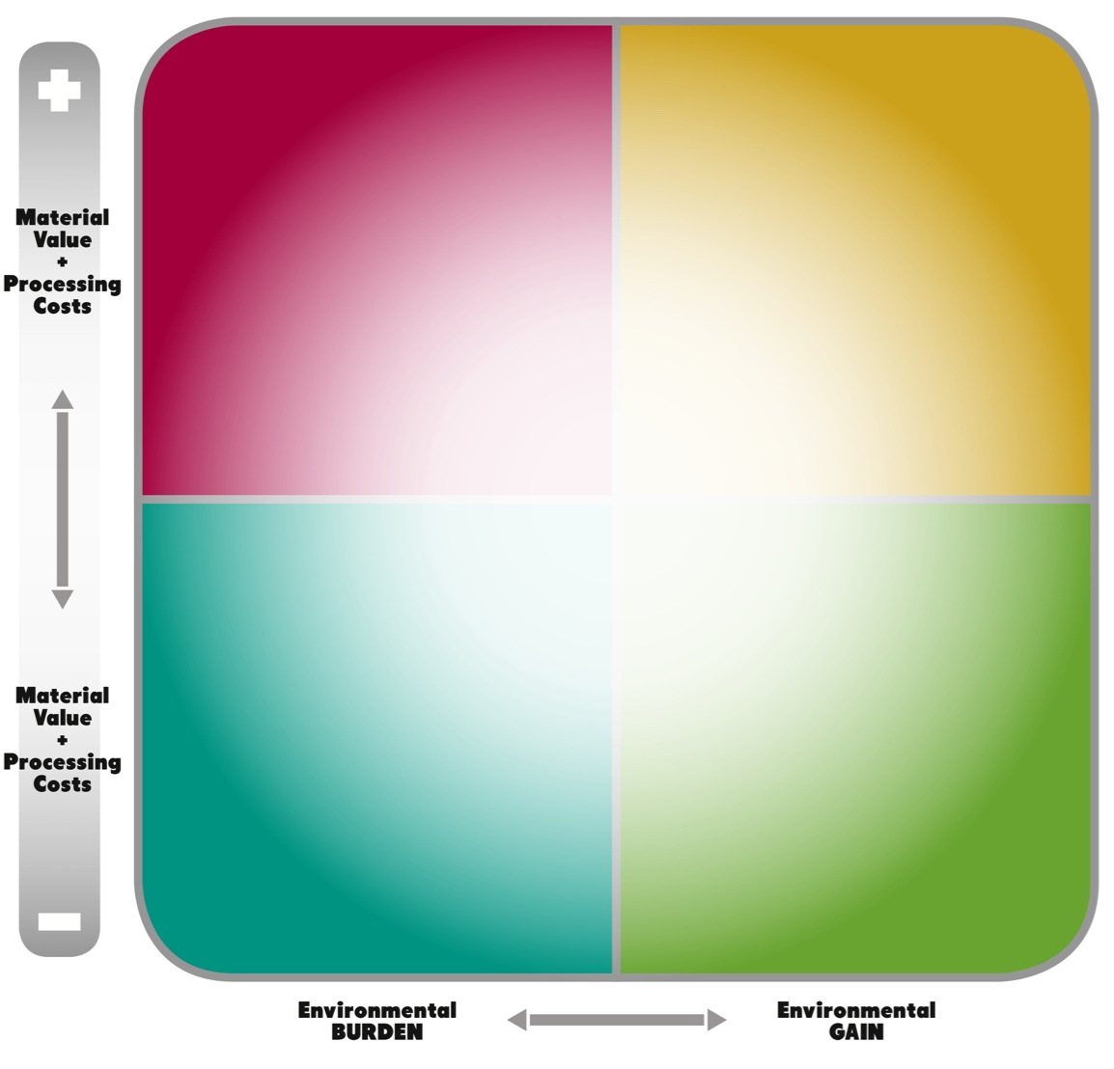




Models for e-waste financing and key principles
Where & why standards, rules & financing?
“Setting” the rules
“Pushing” for Best Available Technologies
Business Perspective
“Shaping” operations
Environmental (Societal) Perspective

Slide 5
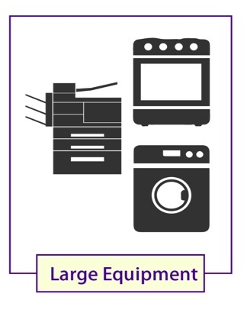
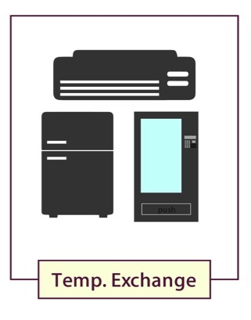
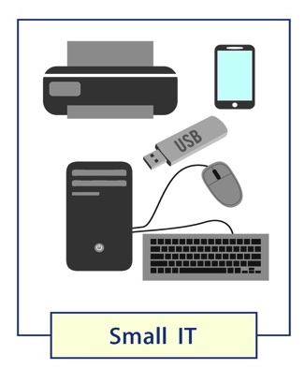

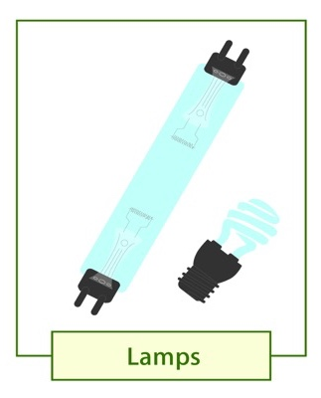
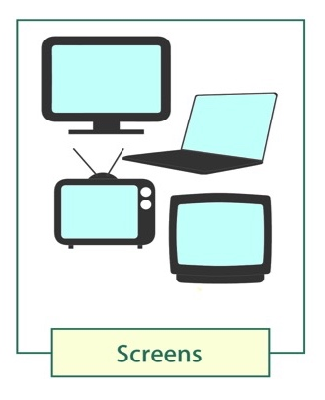
Models for e-waste financing and key principles
Policy Principles: where do WEEE stand?
Even within the same waste stream, NOT ALL PRODUCTS are equal:
C&F: Fridges (negative) vs Air Conditioners (positive)
Mixed WEEE: Mobile phones (very positive) vs small appliances (slightly positive) vs Desktop (very positive) vs Laptop (slightly positive)
Screens: CRT (negative) vs FPD (close to zero)
Large Equipment
Business Perspective
Temp. Exchange
Small IT
Small Equipment
Lamps
Screens
Environmental (Societal) Perspective

Slide 6

Models for e-waste financing and key principles
Roadmap for set-up of a system
Have legal framework in place
  Set rules, responsibilities, financing, penalties,..
(facilitate the) Set up of “management entity”
  Statute & governance
  Staff & resources/infrastructures
  Relationship with other bodies (ministries, stakeholders,…)
Secure financing means
  Implement monitoring & control procedures (incl. audit)
Create the network of collection & recycling partners
  Investment for infrastructures: collection points > consolidation > treatment
  Contractual agreement with recycling partners
  Strategy to integrate informal sector (key is to get volumes)
Kick start operations
  Start, start, start…!!! Don’t be afraid to fail.
Start awareness campaigns
  Lot of changes are requested: consumers (+++), recycling sector (++)
Review performances and optimization never stops
3 to 6 m
6 to 18 m
18 to 24+ m
12 to 18 m
24 to 48 m

Slide 7
How to calculate operations costs and budgeting
Key questions to set-up e-waste scheme
WHO is paying for WEEE Management? (political decision)
Tax-payers (residual, as long as legislation is being deployed)
Consumers (e.g. California, upon purchase product)
Waste holders (e.g. Japan, or non-household streams in EU)
Producers (Extended Producer Responsibility , 98% of policy bills…),
TO WHOM? (political)
State-controlled, monopolistic body - under ministry, or dedicated entity (f.i. California) - or ad-hoc created (f.i. Mauritius)
Compliance Schemes, to be set-up by Producers (having the responsibility to comply)
TECHNICALITIES on how fees are collected (technical)
When importing products, when waste is managed,…
Upon import, once a year, once a month,…
HOW MUCH? (technical + political)

Slide 8
How to calculate operations costs and budgeting
How much to pay? A 7 steps guide
Create the annual budget for operations (€/t): access to waste cost + collection cost + transport cost + treatment cost for each waste streams (technical + political)
  political part is to discuss ”how are individual products clustered into streams?". Is "cross-financing", admitted or not?
Estimate the waste collected (t) (technical)
Calculate total annual cost for operations (€/year): technical cost for operations (#1) * expected quantities (#2) (technical)
Calculate the OH for set-up and running of Compliance Scheme. (technical)
Calculate Total annual costs: Total costs for operations (#3) + OH for waste stream (#4) (technical)
Allocate the Total Costs (#5)to the Producers (technical + political)
  Political decision is whether you decide to allocate costs equally to products in the same waste stream or using different algorithms.
  Impact is on cross-financing.
Decide the revision timeframe (political)
Notes:
There’s 7 steps to calculating how much producers must pay to finance the sound management of e-waste.:
OH costs:
Enforcement: This includes all the costs for enforcement of all legal provisions and the costs for controlling that producers are registered, and that each actor fulfils their own legal responsibility;
Auditing: This includes the costs for auditing treatment facilities and other operations of other relevant actors involved in e-waste management, to ensure all legal provisions associated with the EPR system are adequately enforced;
Awareness Raising: This includes the cost of raising public awareness about the importance of environmentally sound e-waste management, giving indications on how to properly dispose of e-waste and conducting public campaigns;
Guarantees: This include the costs covering the situations where a producer ceases to exist (e.g., goes bankrupt or is no longer active on the market) or for other reasons cannot assume the financing of its share of products put on the market.

Slide 9
How to calculate operations costs and budgeting
Key take-home messages
Do not pretend to make it right on paper: learn by doing
  Do not be afraid of mistakes: for sure after one year you will know much more!
  It’s easier to change (also legislation) with data derived from practice
Keep as much flexibility as possible, particularly on financing
  In EU costs changed radically over the last 10 years
  Areas where you need to invest today, ad different from areas where you need to invest tomorrow!
Create platform to discuss progresses and updates
  At least monthly technical and political committees to review progresses in implementation.

Slide 10
Thank you

