Slide 1
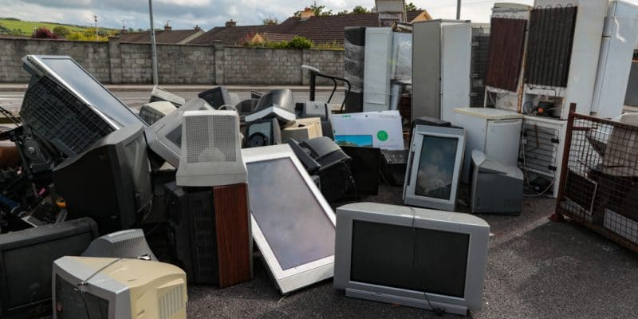
The United Republic of Tanzania Vice President’s Office E-waste Policy and Legal Framework and Enforcement in Tanzania March 2025

Slide 2
Introduction
EMA 2004 is the core legislation for all environmental issues in Tanzania. provides a legal and institutional framework for sustainable environmental management, prevention and control of pollution, waste management, environmental quality standards, public participation, environmental compliance, and enforcement.
Under the EMA 2004, the NEMC is mandated to undertake enforcement, compliance, review and monitoring of environmental impact assessments,
The disposal of hazardous waste is regulated by the Environmental Management Act EMA 2004 and audited by NEMC.
Waste management services in Tanzania are provided by a combination of government agencies and private companies.

Slide 3
INTRO…………..
Local government authorities often play a significant role in waste collection, while private companies are involved in areas such as waste transportation, disposal, and recycling.
Community-based organizations also contribute to waste collection in many areas sorting waste into categories for disposal and recycling, and selling the recyclable plastic, metal, and electronic waste to commercial recycling plants.
Why regulate E-waste?
Its valuable resources that can be recovered
Significant growth in e-waste generation (0.5% of total waste generated in the country)
State of Environment Report 2019 highlighted that e-waste is an emerging environmental threat

Slide 4
Framework
National Environmental Policy 2021
Environmental Management Act 2004
EM (Control and Management of Waste Electrical and Electronic Equipment) Regulations, 2021
The Electronic and Postal Communication (Electronic Communication Equipment Standards and E-waste Management) Regulations, 2020
EM (Charges) Regulations, 2021
The Extended Producer Responsibility (EPR) guideline(Draft)

Slide 5
Framework……………
The government has taken various steps to strengthen waste management in the country, including Enacting Electronic Waste Management Regulations (2021): This regulation:-
Implement producer responsibility for e-waste.
Provides requirements and conditions for the application of a permit to collect, store, and transport e-waste within the country
Enhancing public awareness and participation in pollution reduction.
Enhancing collaboration between government and private sector in investment in waste management.
Strengthening institutions (technically and financially) for effective waste management.
Enhancing regional and international cooperation on pollution control.
Promote environmentally friendly EEE.
Facilitate data collection on EEE and e-waste.

Slide 6
Framework……………..
Sections 133-139 of the Environmental Management Act, 2004 prescribes the requirements to control import, export, transit, internal movement, and disposal of hazardous waste.
Specifically:-
Prior Informed Consent procedures
Local regulatory procedures (in-country permits)
Duty of local governments in hazardous waste management
Duty of the generator of hazardous waste
Multi-sectoral collaboration in disposal of hazardous waste

Slide 7
Framework……………
The Electronic and Postal Communication (Electronic Communication Equipment Standards and E-waste Management) Regulations, 2020 covers:-
Electronic communications equipment imported or manufactured for use in the United Republic
Equipment must be for connection to any electronic communications network to receive or transmit electronic communication signals
Part IV (Section 13-27) Provides roles and responsibilities of various actors including importers
Section 7 (1)(a) requires manufacturers and importers of electronic communication equipment to pay an ecolevy fee in respect of handling the end-of-life of the electronic
Sections 8 and 9 provide the requirement for technical evaluation and functionality test
Section 17(1)(b) requires manufacturers and importers to ensure the collection of e-waste resulting from the end of life of a product complies with the principle of EPR

Slide 8
Framework……………
Environmental Management (charges) Regulations, 2021: This regulation establishes the fees for applications and permits related to collecting, storing, and transporting e-waste within Tanzania.
Environmental Management (fee and charges) Regulations, 2024 (Amendment): This amendment modifies the fee structure for network facilities, as defined by the Electronic and Postal Communications Act.
The amendment replaces the prior fee with a charge of 0.02% of the network facilities' gross annual turnover.
Electrical and Electronic Industries: Deletes the previous Category 19 and substitutes it with a new category specifically for "Electrical and Electronic Industries," provides for the implementation of new, industry-specific fees
The Extended Producer Responsibility (EPR) guideline, 2021 are still under approval processes

Slide 9
Achievements
The pre-inspection and collection of eco levy for all communication devices destined for the URT started on May 23, 2023 conducted under pre-inspection and collection of advance eco-levy project.
The inspection is the implementation of the 2020 regulations on the Electronic and Postal Communications (Electronic Communication Equipment Standards and e-waste Management).
A total of 168,177 electronic communication devices are inspected as of September 30, 2024.
A total of 377 Eco Levy Certificates have been issued as of September 30, 2024.
Also Tanzania currently, has a total of Tanzania has 2 certified dismantling plants and 20 e-waste collectors.

Slide 10
Challenges
Inadequate public awareness on the risks of improper e-waste disposal and the benefits of recycling.
Low number of certified e-waste dealers compared to the e-waste volume.

