Slide 1
Enviroserve Kenya Ltd

Slide 2
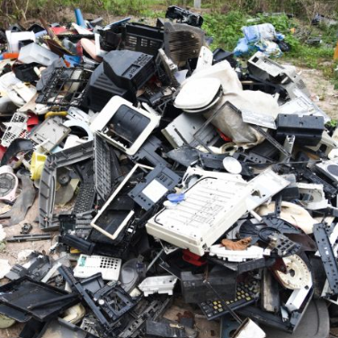
Introduction
At Enviroserve, we're more than just a business - we're on a mission to protect Kenya from the significant dangers to the environment bought by E-waste..
Despite being a commercial enterprise, Enviroserve is environment not profit first. We believe that prevention and reduction of E-waste are the top priorities. We use our technical expertise to solve issues that are challenging the industry
Enviroserve’s focus is to continually strive to find local solutions for E-waste processing.
Enviroserve Kenya Limited (ES) was founded in 2017 to deliver environmentally friendly and sustainable ways of managing electronic waste (E-waste), keeping toxic material out of the environment, unsealed landfill and dumps and contributing to a circular economy that simultaneously provides opportunity for new business initiatives and entrepreneurship.

Slide 3
ES is focused on ensuring recycling is handled responsibly and not just cost effectively and follows the principles of
Re-use / Repair if possible
Recover fractions that can be re-used (metals, plastic, cardboard etc)
Recycle if not
Safely dispose of e-waste that cannot be recovered or recycled

Slide 4
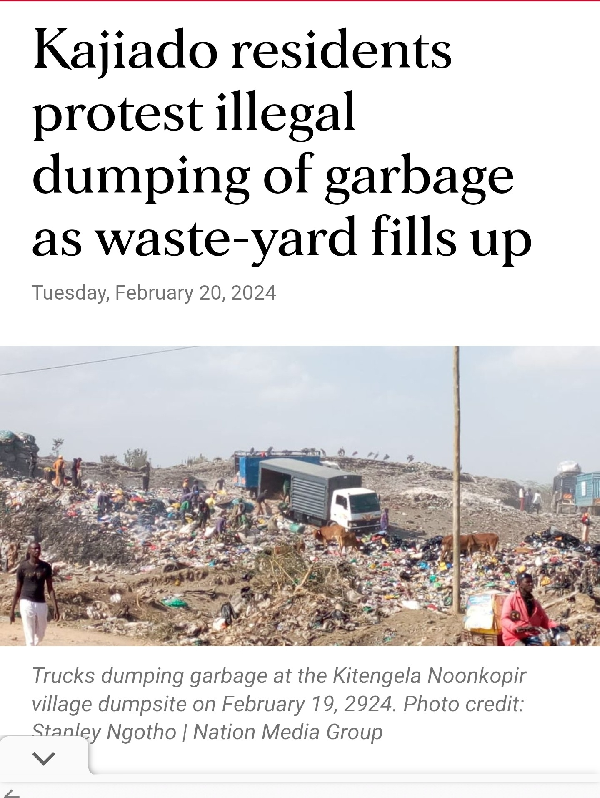
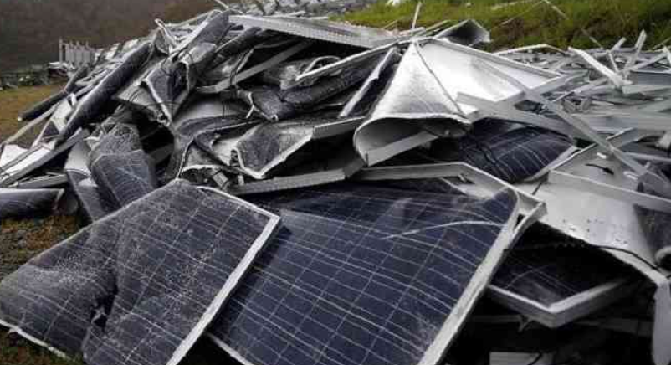
Enviroserve Impact - Hazardous materials are sent to Enviroserve Dubai for further processing or responsible landfill to avoid hazardous elements such as lead, cadmium, berilyium etc being dumped in open landfill. Over 150,000 kgs of potentially toxic materials have been sent by ES to Dubai as there are no certified safe landfill sites operational in Kenya
Responsible Recyclying
Nation newspaper February 2024

Slide 5
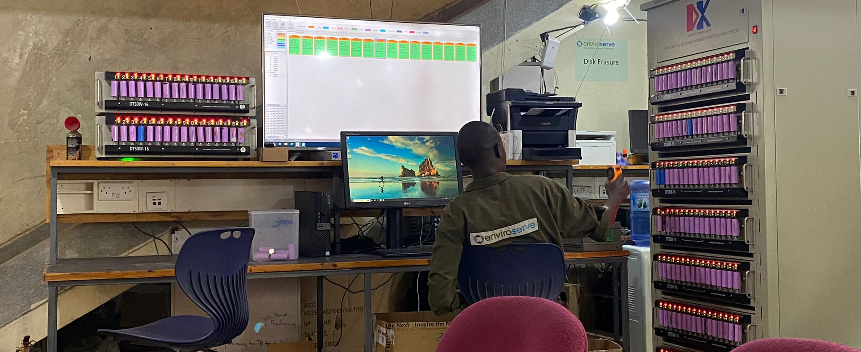
Solving Industry problems
ES collects all range of electronic waste and typically processes it in country providing easily separated fractions like metals and certain plastics to other Kenyan recyclers that specialise on these.
As mentioned, for items requiring safe landfill, ES sends these to ES International in Dubai that provide this service in a certified manner.
Some of the challenges facing the industry in Kenya at the moment, which ES seeks to address with innovative solutions are;
End of Life Lithium-Ion Battery management solutions
Recycling of Solar panels

Slide 6
E-Waste Management Collaboration: Key Areas between govt and private sector
1. Policy & Regulatory Framework
EPR, Other regulations, enforcement
2. Public-Private Partnerships (PPPs)
Joint investment in facilities including disposal facilities
3. Innovation & Technology
R&D partnerships
4. Community Engagement & Capacity Building
Further engagement with informal sector, awareness initiatives

