Slide 1
Pathway to Promote Equity and Equality in E-Waste Management for East Africa Community (EAC) ;Case Study Kenya
Advancing Inclusive and Sustainable Resource Recovery for waste collectors and waste pickers
Presented by:
Eric Guantai,
Circular Economy and Sustainability Consultant,
Nairobi Metro CBOs Waste Management Network

Slide 2
Introduction
The Nairobi Metro CBOs Waste Management initiative is a community-based organization network (150 CBOs with an average figure of 30-60 members) that brings together various grassroots entities engaged in sustainable waste management practices covering all waste streams e-waste inclusive across Nairobi and its metropolitan area covering 17 Constituencies and 85 wards. It represents a collective effort to tackle the growing waste management challenges in urban and semi-urban settings by leveraging community-driven solutions aligned with circular economy principle
Vision;-A society that is safe clean and healthy, free from waste and pollution
Mission –To transform urban waste into a resource through sustainable practices, innovative ,education fostering circular economy

Slide 3
Introduction
Equity & Equality Focus: How do we guarantee inclusive participation and equitable distribution of benefits for all stakeholders, particularly marginalized groups, across both upstream and downstream segments of the e-waste value chain?
Why are the People (enterprises and entrepreneurs inclusive those informally established ) Driving the Circular Economy/EPR Often Left Out of the Agenda?
The journey of informal circular economy (CE) enterprises and entrepreneurs operating across Nairobi’s waste value chain (e-waste inclusive) is marked by structural challenges and systemic inequities. These enterprises, both vertically and horizontally embedded within various waste streams, face multiple exploitative and manipulative pressures driven by diverse layers of vested interests. These dynamics inhibit not only their economic prosperity but also their holistic human development, limiting social and environmental progress.
Informed by intersecting variables such as poverty, social exclusion, and systemic neglect, this community of informal waste entrepreneurs and enterprises is often marginalized—socially, economically, and politically. Despite their unwavering efforts to stimulate economic growth, depollute the urban environment, and foster circularity and EPR , many endure harsh realities, including homelessness and deprivation.

Slide 4
Introduction –cont’d
Nairobi’s urban landscape is home to thousands of informal circular economy (CE) enterprises whose livelihoods depend on waste management. Yet, they are routinely subjected to economic exploitation at multiple nodes across the waste value chain. Recyclable prices fluctuate erratically, payments from Producer Responsibility Organizations (PROs) are inadequate or delayed, and informal actors are often sidelined during the design and implementation of waste management projects, despite being crucial to achieving sustainable waste solutions.
The cumulative impact of this systemic disenfranchisement is profound. Many struggle to secure stable housing and basic necessities, resorting to makeshift shelters that offer little protection from climate extremes. Homelessness in this context is emblematic of entrenched structural inequalities—poverty, limited access to social services, exclusion from formal governance systems, and widespread inequality.
Moreover, a significant proportion of informal circular economy (CE) entrepreneurs originate from historically marginalized communities (waste pickers and waste collectors ), facing daily discrimination and social stigma. The absence of equitable access to education, capital, and secure employment entrenches them further in cycles of poverty and exclusion.

Slide 5
Introduction –cont’d
Despite their essential contributions to Kenya’s low-carbon, circular economy and EPR-PRO ambitions—generating green jobs, reducing waste, and supporting environmental regeneration—informal waste enterprises and entrepreneurs often encounter neglect, predatory business practices, and hostile regulatory frameworks. Upstream actors, including parts of the formal business community and certain regulatory authorities, frequently exploit their vulnerabilities.
Harassment, exploitation, and limited legal protection are common experiences for these front workers. Government policies and urban development plans rarely prioritize or protect their interests, perpetuating a cycle of economic precarity, social marginalization, and environmental injustice.
Addressing these challenges requires an intentional focus on equity and equality, ensuring that informal circular economy enterprises and entrepreneurs are meaningfully integrated into national waste management strategies (e-waste inclusive), urban policy frameworks, EPR and inclusive circular economy models

Slide 6
The E-Waste Landscape
Statistics: By estimation over 50,000 metric tons of e-waste generated annually.
Sources: Household electronics, ICT waste, appliances, batteries, lighting equipment, toys, space and low carbon technologies –drones, solar home systems .
Informal Sector Role: Over 80% of e-waste in Kenya is managed by informal actors who often operate without adequate protection, formal recognition, or support. Despite these challenges, they play a crucial role in decarbonizing producers' operations through e-waste collection, transportation ,spare-part harvesting (re-use) and repair, while contributing to building climate-resilient cities. The sector also serves as a platform for continuous learning, unlearning, and relearning on critical topics, including sustainable products design and adaptable circular and EPR business models.

Slide 7
The E-Waste Landscape –cont’d
The situation underscores the urgent need to integrate principles of equity and equality into e-waste management policies and practices. Recognizing and formalizing the contributions of these informal actors is key to ensuring fair access to resources, safer working conditions, EPR and equal participation in climate-resilient, inclusive, and sustainable economic systems.
By addressing the systemic gaps that perpetuate inequality, we can transform informal waste operations into dignified green jobs that contribute to a more just and circular economy.

Slide 8
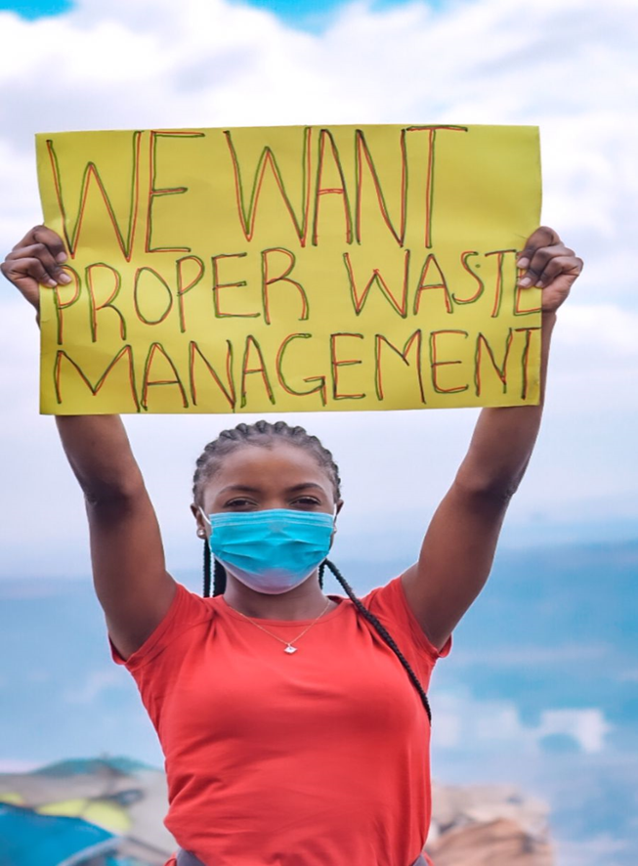
Equity & Equality Gaps in E-Waste Management
Social Disparities: Women, youth, and vulnerable waste workers face exclusion and hazardous working conditions.
Economic Disparities: Limited access to formal markets, funding, training, and technology.
Environmental Injustice: Informal handlers bear disproportionate health and safety risks.
Structural Barriers: Institutionalized culture and fragmented regulatory frameworks limit inclusive participation.

Slide 9
Equity & Equality Gaps in E-Waste Management –Cont’d
Predatory Regulatory Instruments: Burdensome and unbalanced policies hinder the fair participation of enterprise and entrepreneurs both formal and informal.
Unfriendly Business Ecosystem: Complex permitting processes and lack of incentives discourage equitable engagement in e-waste management .
Lack of Enablers: Absence of supportive infrastructure, technology,standards and financial mechanisms impairs inclusive growth in e-waste as a business activity.
Unfair Market Dynamics: Unfair pricing of primary and secondary recyclable materials from e-waste affects income distribution Across e-waste value chain , in ability to meet basic needs lead to homelessness for waste pickers

Slide 10
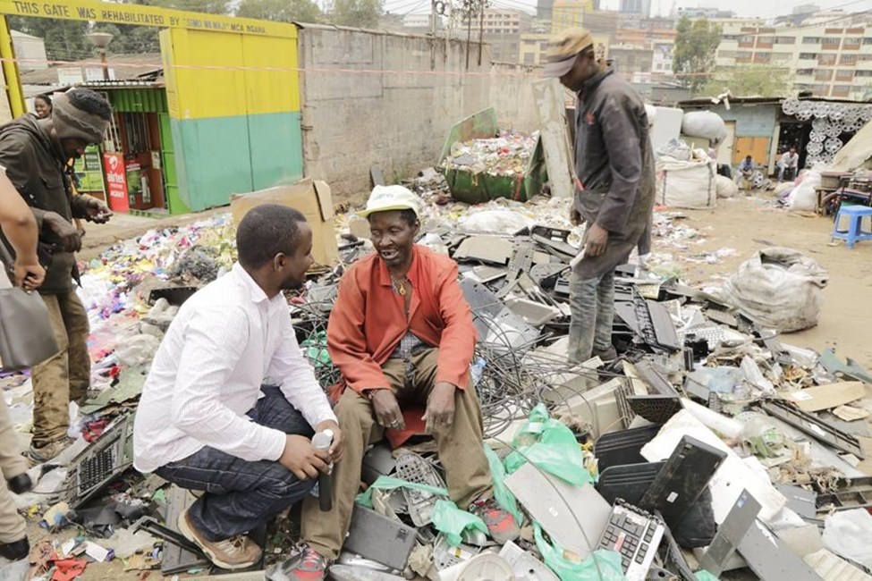
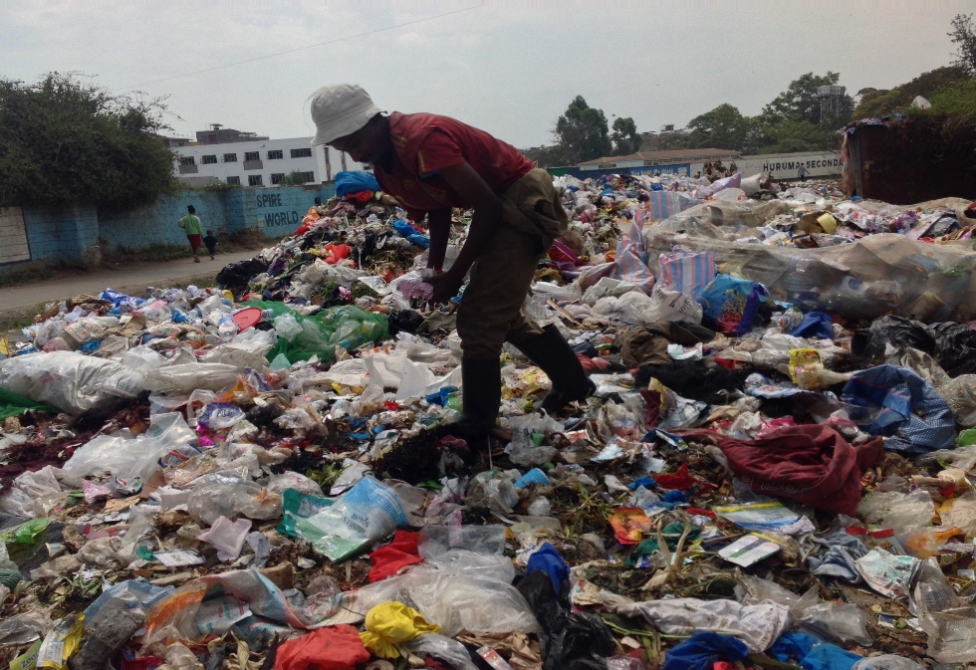
Equity & Equality Gaps in E-Waste Management –Cont’d
EPR Fund Inequities: Inadequate and delayed disbursement of EPR funds to grassroots waste collectors impedes equitable development.
Data Gaps: Absence of data tailored to addressing equity and equality gaps across the e-waste value chain, covering all cross-cutting thematic areas both upstream and downstream.

Slide 11
Equity & Equality Gaps in E-Waste Management –Cont’d
Regulatory Gaps: Isolating repairers from EPR frameworks and the absence of regulatory structures around repair services widens equity and equality gaps within Kenya's e-waste management system.
Gender Lens: Women face unique barriers such as lack of access to formal training, capital, and market linkages, limiting their participation in decision-making and leadership roles within the e-waste sector.
Standards Perspective: Standards through the lenses of Equity and Equality are urgently needed across e-waste value chains, both upstream and downstream, to promote fairness and inclusivity.

Slide 12
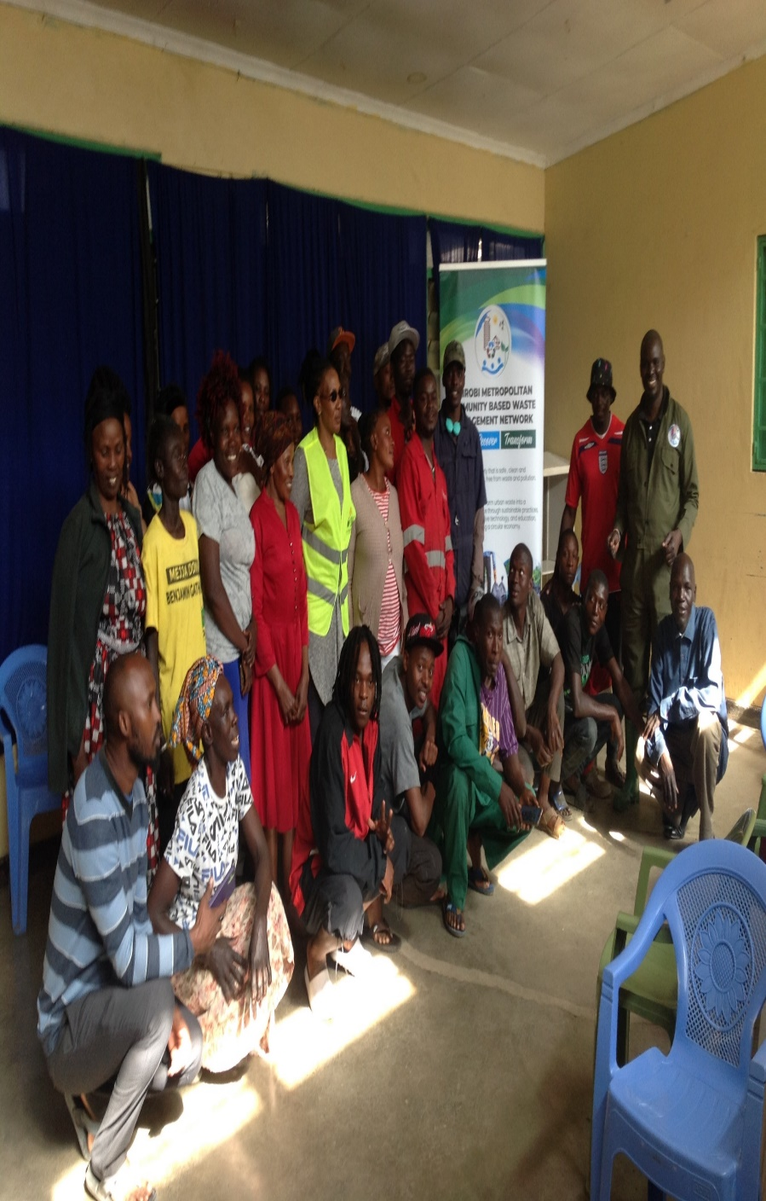
Why Equity & Equality Matter
•Sentiment: "A just transition leaves no one behind. Equity is the bridge to sustainability."
•Benefits:
Empowered waste workers.
Safer working environments.
Stronger local economies.
Improved circularity and resource recovery

Slide 13
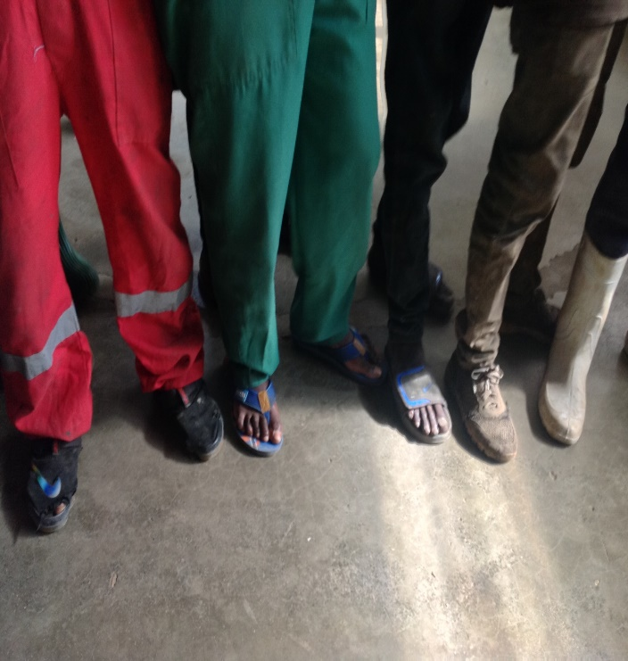
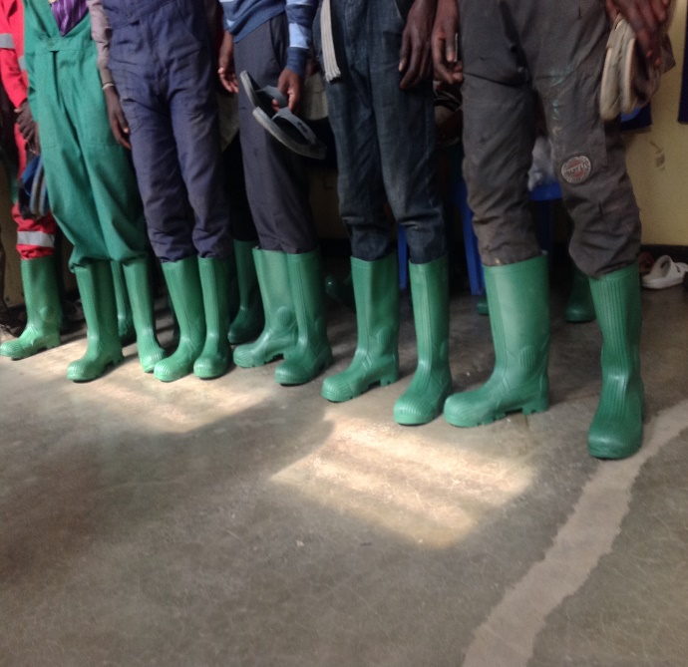
Pathway to Equity & Equality
1)Recognition of Informal Sector Contributions
4)Capacity Building & Skills Development
2)Formalization & Inclusion in EPR and Circular Economy Programs
5)Access to Finance, Tools, and Infrastructure
3)Strengthened Legal and Policy Frameworks
6)Multi-Stakeholder Partnerships (Private Sector, Government, Communities)

Slide 14
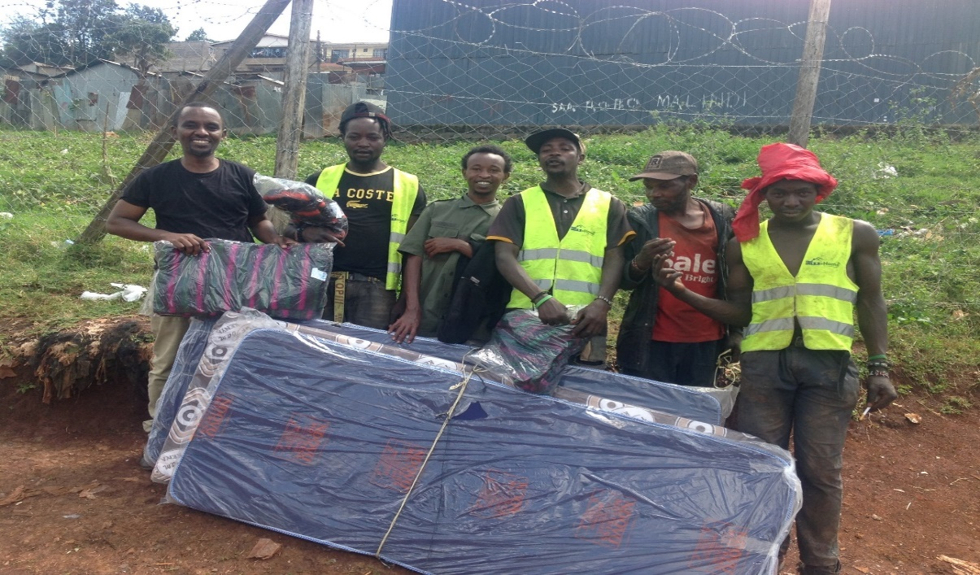
Pathway to Equity & Equality –cont’d
7) Reforming Market Practices: Address unfair pricing of recyclable materials and ensure transparent EPR fee disbursements.
8) Policy Inclusion for Repairers: Integrate repairers into EPR mechanisms and develop supportive regulatory frameworks to bridge equity gaps.
10) Gender-Sensitive Programming: Promote equitable access and leadership for women and other marginalized groups in the e-waste value chain.

Slide 15
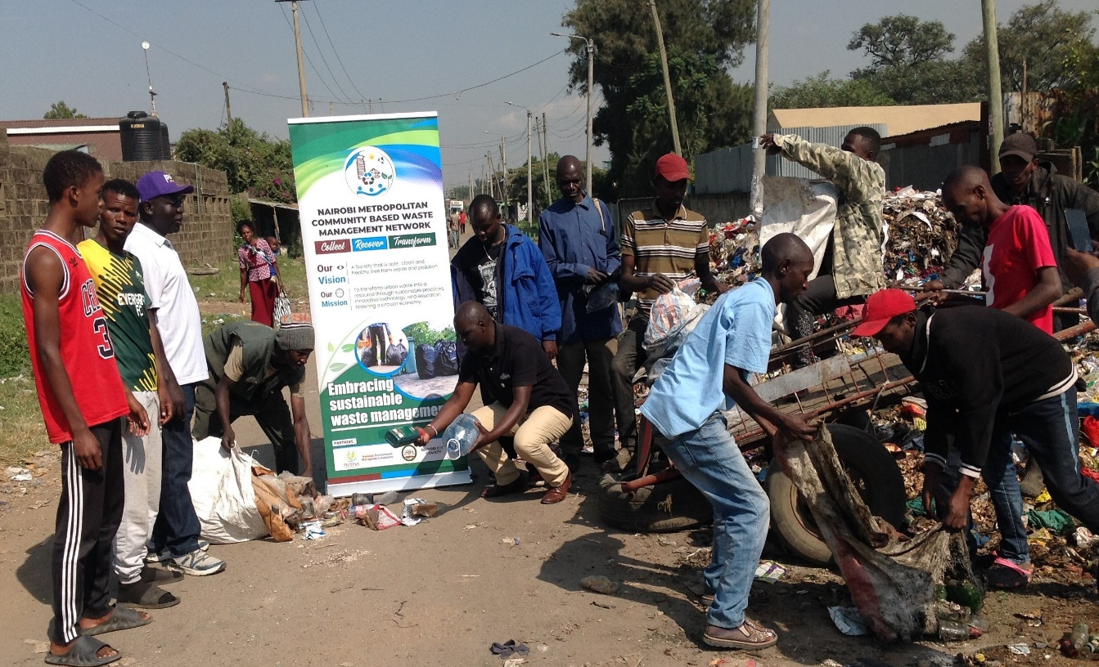
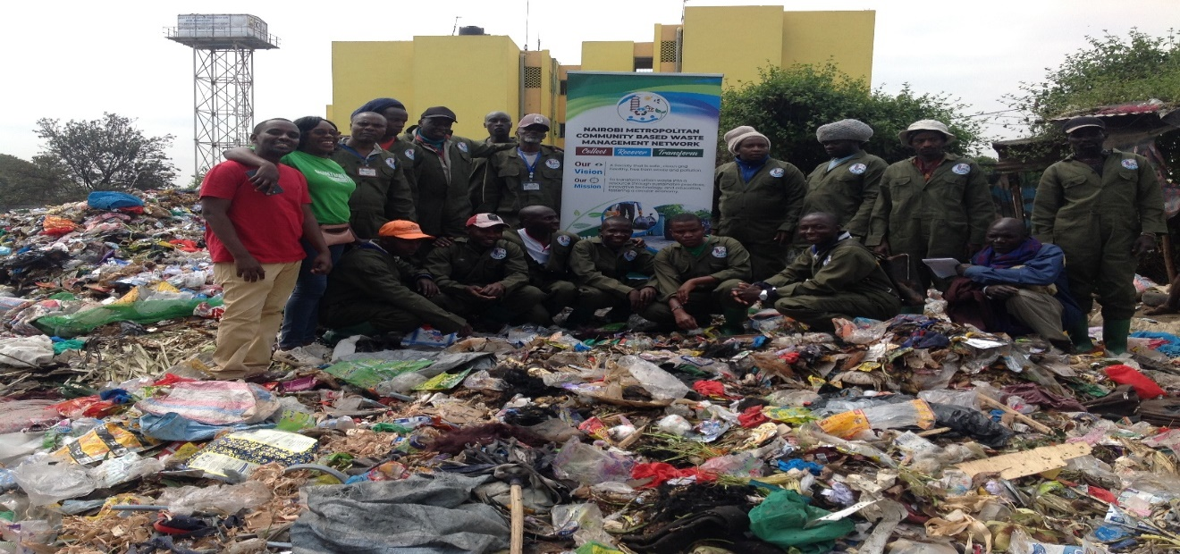
Equity & Equality ;Circular Economy as a Catalyst
E-waste Circular Model:
Repair, refurbish, repurpose, and recycle.
Inclusive Supply Chains:
Integrating waste pickers, collectors , transporters, repairers, and recyclers.
Equity Lens: Ensure all actors, regardless of gender or status, benefit fairly from the circular economy

Slide 16
Equity & Equality; Trash to Cash Circular Economy
Bad ideas and failures are not adversaries; they are vital milestones on the path to creating work that is not only innovative but transformative. In the context of the Trash to Cash Circular Economy through EPR , these experiences catalyze fresh thinking and foster adaptive solutions that convert e-waste and consumables into sustainable economic value.
More importantly, embracing missteps is critical to building a circular economy through EPR that champions equity and equality. By learning from challenges and re-centering marginalized waste actors—particularly waste pickers and waste collectors —this model ensures that benefits and opportunities are distributed fairly across the entire value chain. In doing so, we create pathways for inclusive growth, environmental regeneration, and a future where prosperity is accessible to all.

Slide 17
Equity & Equality; Leveraging EPR & ESG Frameworks
EPR: Unlocking funds for grassroots e-waste actors.
ESG Compliance: Corporates championing equitable and responsible waste practices.
Producer Responsibility Organizations (PROs): Partnerships to facilitate fair distribution of resources (human and Financial and capacity support across e-waste value chain downstream; e-waste collector , e-waste picker , e-waste transporter, e-waste aggregators/transfer stations ,e-waste recycling facility
Leveraging these EPR and ESG frameworks requires the intentional development of policies and investment frameworks that recognize these informal actors as critical partners in scaling circularity and climate action. By centering equity and equality, governments, financial institutions, and private-sector partners can unlock the full potential of circular economy ecosystems, ensuring a just transition and broader socio-economic resilience.

Slide 18
Equity & Equality; SDGs ,Funding and Economic Empowerment
Forging robust alliances between the scientific community, business sector, and financial institutions is fundamental to actualizing impactful, climate-friendly solutions on a global scale. Such partnerships serve as critical enablers for advancing EPR –PROs blueprints that are both innovative and actionable.
Specifically, integrating science plus indigenous driven insights with capital investment and business ingenuity is essential to unlocking the full potential of circular and EPR-PRO solutions across e-waste streams, and the vital role of waste collectors and waste pickers . These synergies not only accelerate the transition to resource-efficient and low-carbon economies but also empower frontline actors, particularly informal waste sector, who are indispensable to the circular and EPR ecosystem.
Moreover, embedding principles of equity and equality within these partnerships ensures that the benefits of a circular economy and EPR are shared fairly across all social strata. This approach prioritizes gender inclusion, economic justice, and access to opportunities for marginalized communities throughout the e-waste value chain.
Through coordinated efforts, we can foster systems that regenerate natural capital, reduce emissions, and create inclusive economic opportunities—laying the foundation for a climate-resilient, socially just, and equitable future.

Slide 19
Equity & Equality; SDGs ,Funding and Economic Empowerment-Cont’d
Sentiment: "Equity is empowerment. Circular economy is prosperity.“
The SDG framework serves as a platform to advance equity and equality across the e-waste value chain, ensuring marginalized groups- (waste pickers and waste collectors) participate meaningfully and benefit equitably from market opportunities, policy interventions, and capacity-building initiatives

Slide 20
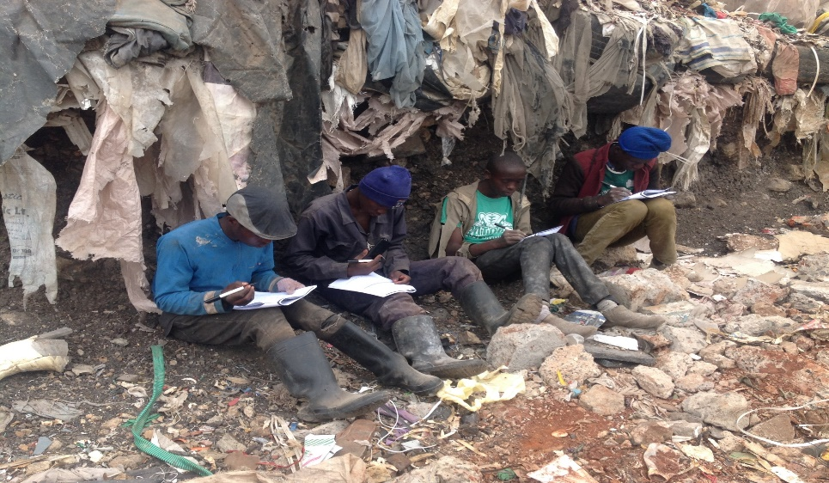
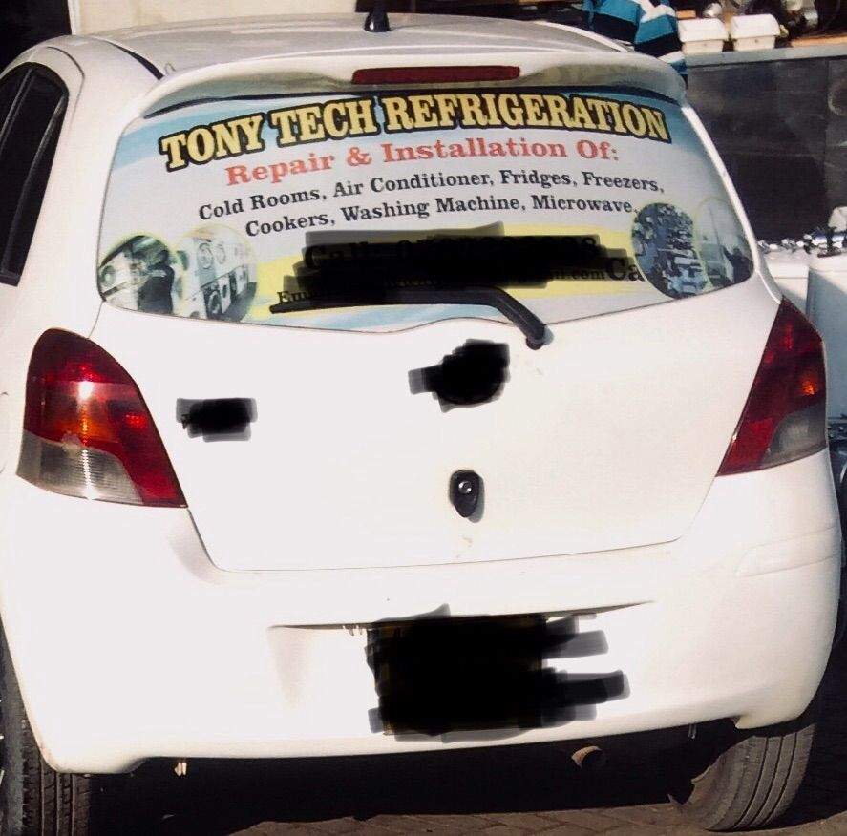
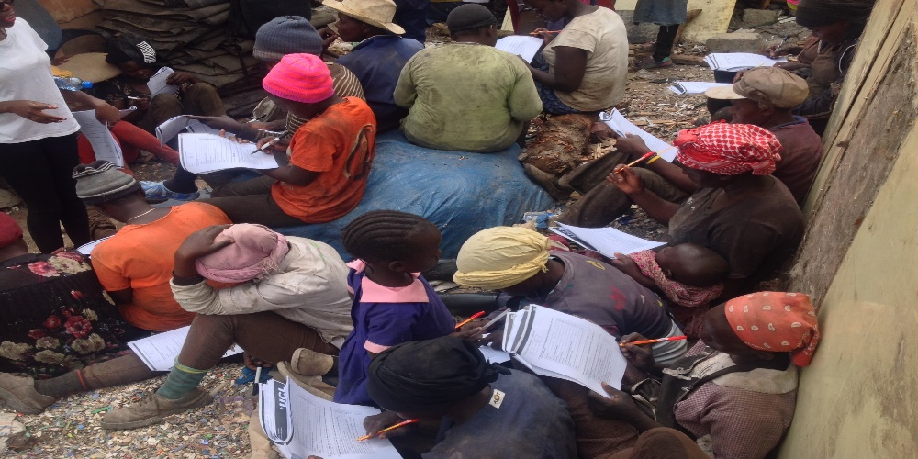
Equity & Equality ;Case Studies / Best Practices ; Nairobi Metro CBOs Waste Management Network
Example 1: Inclusive e-waste cooperatives in Nairobi; on going .
Example 2: Gender-responsive e-waste repair and refurbishment enterprises; through our partners
Example 3: Informal sector e-waste training programs linked to formal e-waste aggregators /transfer station, e-waste recycling facilities; on going
Waste collection; 1.6 Million households covered –Nairobi Metropolitan Areas( Nairobi County and its environs) equal to
7 million plus

Slide 21
Role of Nairobi Metro CBOs Waste Management Network
Circular Economy Service Providers: Facilitate repair, refurbishment, and spare part recovery, contributing to waste reduction.
Circular Economy Supply Chains: Engage in collection, transportation, and sorting of e-waste, linking upstream waste generators to downstream markets.
Support to Secondary Markets: Provide feedstock and logistical support to recyclers, exporters, and spare parts markets.
Advocacy: Champion for equitable participation of informal actors in circular economy initiatives and EPR frameworks.
Capacity Development: Offer training and support programs to enhance the skills of waste collectors and circular economy entrepreneurs.

Slide 22
Our Commitment & Call to Action
Commitment: Advocate for an equitable and sustainable e-waste ecosystem leveraging on waste pickers and waste collectors roles as EAC-EACO region.
Next Steps:
Build partnerships.
Mobilize funding.
Enhance inclusive policy development.
Promote awareness and stakeholder engagement.
Sentiment: "Together, we can close the gap between equity and environment."

Slide 23
EAC Commitment & Call to Action-cont’d
EAC-EACO policymakers hold a pivotal responsibility in translating international protocols and treaties into actionable reforms that tangibly improve the operating environment for e-waste entrepreneurs and enterprises across the East Africa. By championing the harmonization of regulatory frameworks and facilitating intra-African trade / African Continental Free Trade Area, they can unlock new pathways for e-waste enterprises to thrive.
A strategic focus on fostering regional collaboration on equity and equality for frontline workers in waste management –waste pickers and waste collectors will be key—enabling East Africa Members State to trade more effectively with one another while building specialized regional e-waste recycling hubs and collection networks rooted in EPR frameworks and circular economy principles. These efforts will not only stimulate green industrialization and innovation but also drive inclusive job creation, promote equity and equality, and enhance Africa’s capacity to manage e-waste responsibly, reducing its environmental and social burdens.
Ultimately, the proactive engagement of policymakers is essential to building a resilient, equitable, and self-sufficient e-waste circular economy that serves both people and the planet.

Slide 24
Thank You
Contact Information
Closing Sentiment: "For people, planet, and prosperity
Eric Guantai
Guantaierick@gmail.com
(+254) 724 722 398
https://www.linkedin.com/in/eric-guantai-0959512b/

