Slide 1
E-Waste and Put on Market (POM) Data Analysis
Presentation for E-Waste Conference
By [Linah Ngumba- Kenya National Bureau of Statistics] | [26/03/2025]

Slide 2
Overview of E-Waste & POM Data
- E-Waste refers to discarded electrical and electronic equipment (EEE)
- Understanding POM data is crucial for estimating e-waste generated
- Data is categorized using international classification systems (EU-6, UNU-KEYS)
- Estimations based on imports, exports, and domestic production of EEE

Slide 3
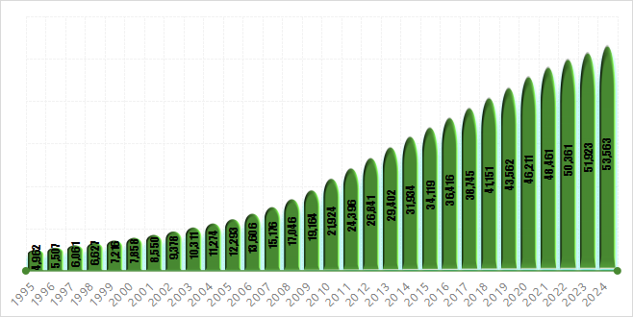
E-WASTE GENERATED IN METRIC TONNES 1995-2024 IN KENYA
Notes:
Total e-waste has gone from 5 million tonnes in 1995 to over 53 million tonnes in 2024—over a tenfold increase. Small equipment like household gadgets and appliances make up the largest share, but other categories, such as screens and temperature exchange equipment, are also growing rapidly.

Slide 4
What the E-waste Statistics looks like
E-waste generation has soared from ~5 million tonnes (1995) to over 53 million tonnes (2024).
Roughly a tenfold increase, with high compounding annual growth (~8–9%).
Small Equipment dominates total volume.
Temperature Exchange and Screens also rising quickly.
Multiple product categories contribute significantly; each presents unique challenges and opportunities.

Slide 5
Broad E-Waste Categories
Notes:
Temperature exchange equipment 11006 Screens, monitors, and equipment containing screens (..) 5715 Lamps 4844 Large equipment (excluding photovoltaic panels) 5680 Small equipment 19738 Small IT and telecommunication equipment 6581

Slide 6
CATEGORY | DESCRIPTION / EXAMPLES
TEMPERATURE EXCHANGE EQUIPMENT | More commonly referred to as cooling and freezing equipment. Typical equipment includes refrigerators, freezers, air conditioners, heat pumps.
SCREENS, MONITORS | Typical equipment includes televisions, monitors, laptops, notebooks, and tablets.
LAMPS | Typical equipment includes fluorescent lamps, high intensity discharge lamps, and LED lamps.
LARGE EQUIPMENT | Typical equipment includes washing machines, clothes dryers, dish-washing machines, electric stoves, large printing machines, copying equipment, and photovoltaic panels.
SMALL EQUIPMENT | Typical equipment includes vacuum cleaners, microwaves, ventilation equipment, toasters, electric kettles, electric shavers, scales, calculators, radio sets, video cameras, electrical and electronic toys, small electrical and electronic tools, small medical devices, small monitoring and control instruments.
SMALL IT | Typical equipment includes mobile phones, Global Positioning Systems (GPS), pocket calculators, routers, personal computers, printers, telephones.

Slide 7
Challenges & Limitations in E-Waste Measurement
- Dependency on trade data (Imports/Exports) where domestic production is absent
- Data gaps in informal e-waste recycling sectors
- Need for capturing E-waste disposal methods from household and enterprise level

Slide 8
Recommendations for Policymakers & Stakeholders
- Enhance e-waste tracking through standardized reporting
- Strengthen data collection for imports, exports, and domestic sales
- Implement policies to regulate informal e-waste recycling
- Promote circular economy strategies for sustainable e-waste management

Slide 9
END-
Thank you for your attention

