Slide 1


8TH EACO EÖ-WASTE AWARENESS WORKSHOP, KINSHASA DRC
ITU-T Study Group 5 (Environment, climate action, circular economy and electromagnetic fields)
WORK ON E-WASTE MANAGEMENT
Helen Nakiguli,
Uganda Communication Commission
Chairperson ITU-TSG5 Regional Group for the African Region

Slide 2



International
Telecommunication Union (ITU)
The International Telecommunication Union (ITU) is the United Nations specialized agency for information and communication technologies (ICTs)
194
Member States
Moscow
New York
Geneva
New Delhi
+700
Companies/ organizations
Bridgetown
Cairo
Tegucigalpa
Dakar
Addis Ababa
Bangkok
Yaounde
Jakarta
+160
Academia members
Brasilia
Harare
Santiago

Slide 3


ITU Resolutions on Environment, EMF, Climate Change and Circular Economy
ITU Resolution 182 – “Role of telecommunications/information and communication technologies in regard to climate change and the protection of the environment”
ITU Resolution 176 – “Measurement and assessment concerns related to human exposure to electromagnetic fields”
ITU-T Resolution 79 – “Role of telecommunications/information and communication technologies in handling and controlling e-waste from telecommunication and information technology equipment and methods of treating it”
ITU-T Resolution 72 – “Measurement and assessment concerns related to human exposure to electromagnetic fields”
ITU-T Resolution 73 – “Information and communication technologies, environment, climate change and circular economy”

Slide 4




ITU-T SG 5: Key Areas of Work
Continually addressing EMC, resistibility, and lightning protection. Furthered research on minimizing the potential health risks from EMF.
Development of standards that promote the integration of sustainable practices in the ICT sector, focusing on energy efficiency, resource management.
EMF and EMC
Sustainable DT
Key Areas
of Work
GHG Emissions
Circular Economy
Development of standards and guidelines that help reduce the carbon footprint of ICT operations, contributing to global climate goals.
Support the transition to a circular economy within ICT, encouraging the strong e-waste management practices and the adoption of circular design principles.
Notes:
First, in the field of Electromagnetic Fields—we advanced research and established guidelines that ensure the safe deployment of ICT infrastructure while minimizing potential health risks from EMF exposure.​
​
Next, under Sustainable Digital Transformation, we focused on developing standards that promote the integration of sustainable practices in the ICT sector, emphasizing energy efficiency and resource management.​
​
We’ve also made strides in supporting the Circular Economy by promoting strong e-waste management practices and encouraging the adoption of circular design principles within the ICT sector.​
​
Finally, in the area of Greenhouse Gas Emissions, we developed standards and guidelines that help reduce the carbon footprint of ICT operations, thus contributing to global climate goals. And also providing a methodology on how to measure the positive impact of ICT solutions in other sectors.
The work was organized in three Working Parties, one focusing on EMC, lightning protection and EMF, the other one on Environmental efficiency, e-waste, circularity and sustainable ICT networks and the third one on climate change, adaptation, mitigation and net zero emissions.

Slide 5











1/5
2/5
3/5
4/5
Electrical protection, reliability, safety, and security of telecommunication/ICT systems
Equipment specification and component/device for protection against lightning and other phenomena
Assessment of human exposure to electromagnetic fields (EMFs)
Electromagnetic compatibility (EMC) aspects in telecommunications /ICTs
WP1/5
SG5 Structure
(Study Period 2025-2028)
6/5
7/5
Environmental efficiency of telecommunications/ICTs
E-waste, circular economy, and sustainable supply chain management
WP2/5
PLEN
8/5
Guidance and terminology on environment
9/5
11/5
12/5
Assessing the impact of telecommunications /ICTs on climate change, biodiversity and the environment - including the influence on other sectors
Climate actions and adaptation to climate change through sustainable and resilient telecommunications/ICTs (including new and emerging)
WP3/5
Climate change mitigation and smart energy solutions

Slide 6





ITU-T SG5 AFR – Strengthening Africa Participation – WG on E-waste management to achieve a Circular Economy
Key Recommendations
7/5
E-waste, circular economy, and sustainable supply chain management
Sustainable management of E-waste and Supply Chain
  ITU-T L.1015 “Criteria for evaluation of the environmental impact of mobile phones”
  ITU-T L.1035 “Sustainable Management of Batteries”
  ITU-T L.1060 “General principles for the green supply chain management of information and communication technology manufacturing industry”
ITU-T L.1036 “Scheduled waste management for a base station (inclusive of e-waste)”
ITU-T L.1037 “Requirements for the collection, transportation, storage, dismantling, valorization and final disposal of waste electrical and electronic equipment”
Scope
Waste management and circular lifecycle for ICT equipment
Sustainability metrics and circular economy performance assessment
Sustainable ICT supply chains, materials recovery, and circular cities
Digital product passport
  ITU-T L.1070 “Global digital sustainable product passport opportunities to achieve a circular economy”
  ITU-T L.1071 “A model for digital product passport information on sustainability and circularity”
Circular Economy
  ITU-T L.1022 “Circular Economy: Definitions and concepts for material efficiency for Information and Communication Technology”
  ITU-T L.1023 “Assessment method for circular scoring”

Slide 7
Key ongoing work of interest for Africa (1)
L.ICT4RD
Methodology of Using ICTs to Manage the Recycling and Disposal of E-waste
L.CRT-EoL
Guidelines for sustainable management and safe disposal of Cathode Ray Tube waste
L.SPV_EOL
Framework and Requirements for Sustainable End-of-Life Management of Solar Photovoltaic
L.UPCSW
Universal power adapter for smart watches and smart bands

Slide 8
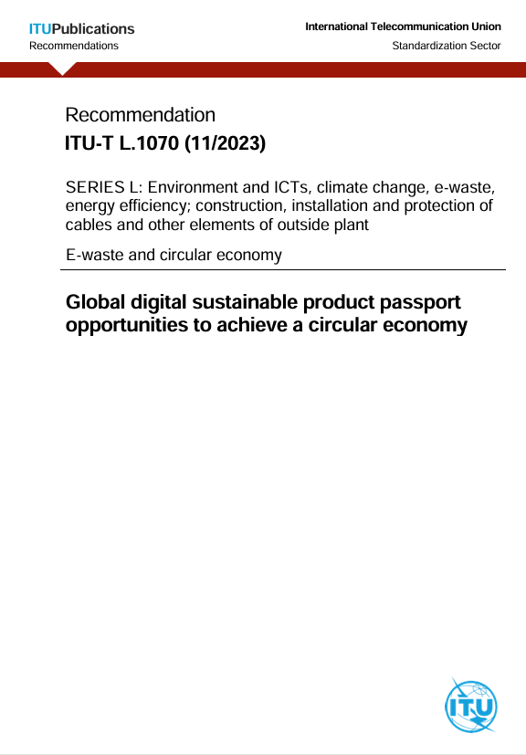
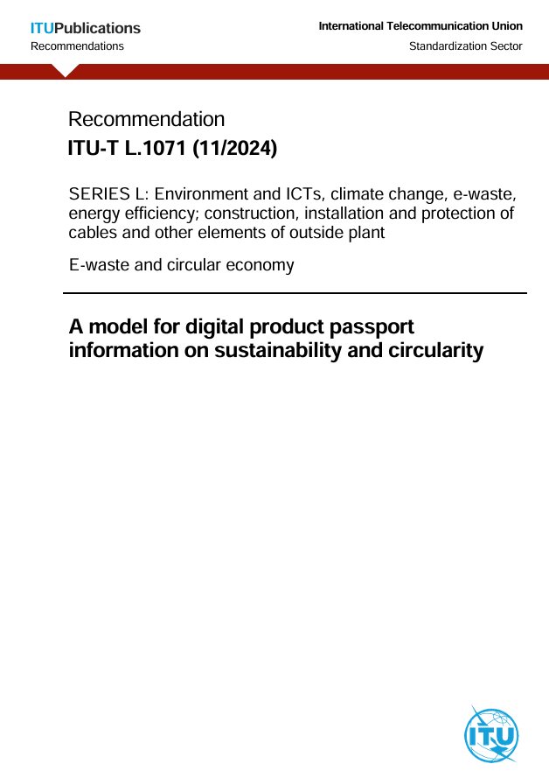
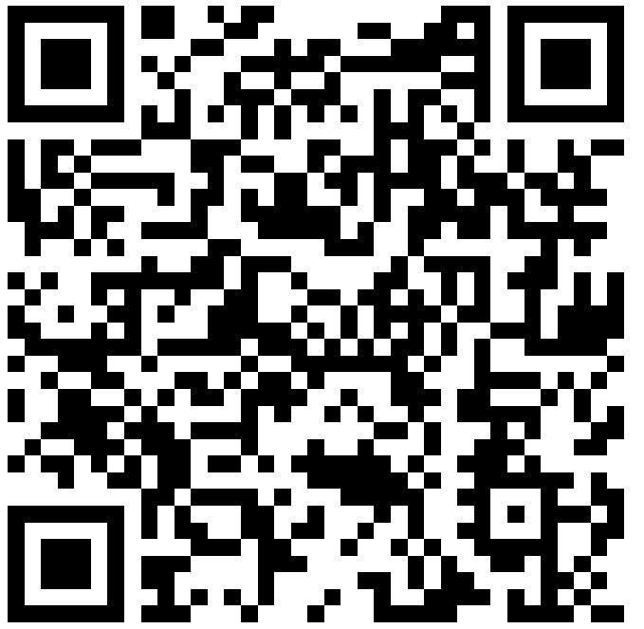

Key ongoing work of interest for Africa (2)

Slide 9
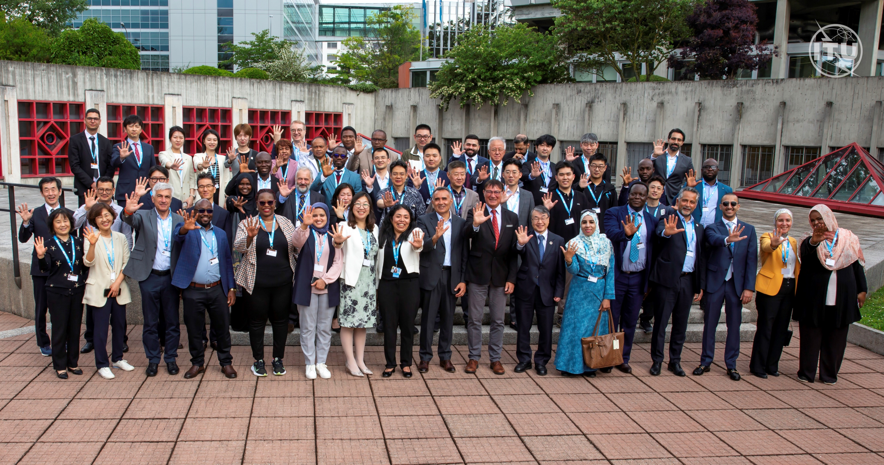



New Standard under development
L.DPIS - Guidelines for a modular and scalable data system design for Digital Product Information Systems (DPIS) for ICT goods
Relevant data categories and subcategories, in order of importance.
Support the design of DPIS approaches for ICT products, facilitating:
  traceability,
  circularity, and
  informed decision-making across the product life cycle.
Data categories
General product information
Materials and composition
Instructions and lifecycle information
Environmental life cycle assessment
Social life cycle assessment
Compliance
Circular Economy R-Strategies
Regional Consultation
ITU-T SG5 Regional Group for Africa (SG5RG-AFR)
Date: 21-22 May 2026
Venue: Malabo, Equatorial Guinea
Inputs are welcome
Notes:
This prioritization could determine whether the information is mandatory, or voluntary depending on the context and use case

Slide 10

ITU-T Study Group 5 Regional Groups
SG5RG-ARB
ITU-T SG5 Regional Group for the Arab Region (SG5RG-ARB)
SG5RG-AP
ITU-T SG5 Regional Group for Asia and the Pacific (SG5RG-AP)
SG5RG-AFR
ITU-T SG5 Regional Group for Africa (SG5RG-AFR)
SG5RG-LATAM
ITU-T SG5 Regional Group for Latin America (SG5RG-LATAM)

Slide 11


ITU-T Study Group 5 Regional Groups
Africa
SG5RG-AFR
Arab Region
SG5RG-ARB
Asia & the Pacific
SG5RG-AP
Latin America
SG5RG-LATAM
Why are regional groups important?
Strengthen the participation of experts from the region in the work of ITU-T SG5
Discussion of the priority of the region
Preparation of joint contributions to advance the standardization work
Share knowledge and best practices among countries of their region
ITU-T regional groups play a crucial role in promoting inclusivity, collaboration, and regional cooperation in the development of international ICT standards.
Resolution 54 - (Rev. New Delhi, 2024) - Regional groups of study groups of the ITU Telecommunication Standardization Sector

Slide 12








ITU-T SG5 Regional Group for Africa (ITU-T SG5RG-AFR)
Management Team
Key priorities identified
Chair
Helen Nakiguli Sekasala
Uganda
16th Symposium on ICT, Environment, Climate Change and Circular Economy
Human Exposure to Electromagnetic Fields
E-waste management to achieve a Circular Economy
Vice Chairs
Dereck Kondwani
Hoda Shakra
Jean BaptisteYetondji Houeyetongnon
William Mnyippembe
Anita Hodari Batamuliza
Benin
William Mnyippembe
Main Topics:
Environmental footprint
Sustainable digital infrastructure
Circular economy & transparency
Regional capacity & engagement
Tanzania
Hoda Shakra
Smart Energy
Sustainable Digital Transformation
Egypt
Olivie Nakamatte
Helen Nakiguli
Derrick Simiyu Khamali
Upcoming meeting
19-22 May 2026
Malabo, Republic of Equatorial Guinea

Slide 13
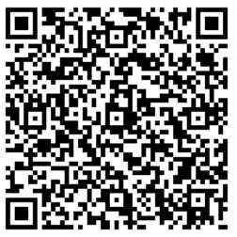
Join us - SG5RG-AFR Preparatory Workshop Series on
ITU-T SG5 Participation
Workshop 1: Overview of SG5 work programme and African priority topics
Online, 24 March 2026, 10h00-11h30 CET
More information and registration
📘 Overview of ITU-T Study Group 5 - Structure, Questions & key deliverables
🎯 SG5RG-AFR Priority Topics identified by SG5RG-AFR
🤝 Opportunities for Contribution from governments, industry & academia
🧭 How to Engage in SG5 and participate in standardization
🌱 Integrating Regional Priorities into global SG5 work
Workshop 2: Guidance on preparing contributions for SG5RG-AFR and SG5 meetings
Online, 14 April 2026, 10h00-11h30 CEST
📝 Step-by-step guidance on preparing ITU-T contributions
📄 Overview of document structure, contribution types, and submission procedures
🌍 Support for African delegates to develop draft inputs aligned with SG5 Questions and
SG5RG-AFR priorities
🚀 Preparation of contributions for consideration at SG5RG-AFR and potential submission to SG5
Notes:
This prioritization could determine whether the information is mandatory, or voluntary depending on the context and use case

Slide 14
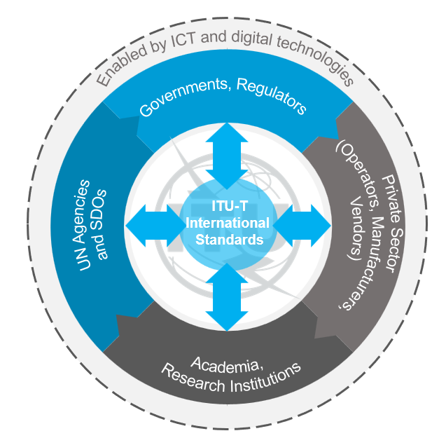














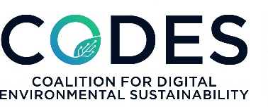

Bringing countries and industries together to help industry and governments.
A mutually beneficial partnership.
Strengthening Collaboration and
Implementation of Standards ​
Collaboration Across UN Agencies
Collaboration with other SDOs
Collaboration with other Organizations

Slide 15


Thank you!
Email
tsbsg5@itu.int
environmentalstandards@itu.int
Website
​​​​​​​​​​​​​​​​​​​​​​​​​​​​​​​​SG5 - Environment, EMF, climate action & circular economy
Notes:
And if this movement and vision for a sustainable future excites you, I encourage you all to get involved! Thank you for your attention and please don't hesitate to reach out to us.

