Slide 1

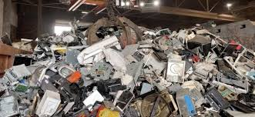
8TH EACO E-WASTE AWARENESS WORKSHOP
KINSHASA, DRC: 16-18 MARCH 2026
ICT E-WASTE COLLECTION IN PRACTICE: EVIDENCE AND LESSONS FROM UGANDA’S PILOT PHASE
Helen Nakiguli, Manager Environment Management
Uganda Communications Commission (UCC)

Slide 2
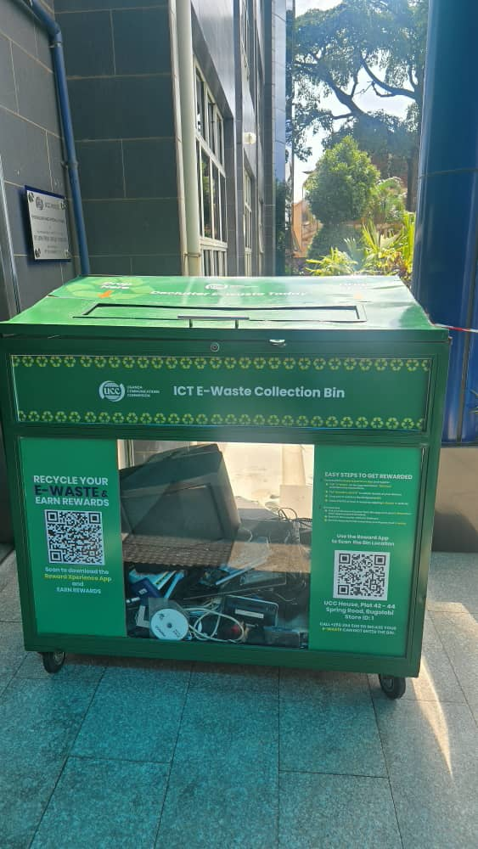
COLLECTION: THE FIRST STEP IN THE E-WASTE MANAGEMENT VALUE CHAIN
EoL devices remain in homes and offices
Materials leak into informal and uncontrolled disposal pathways
Recycling and circular economy opportunities are lost
*collection acts a gateway to environmentally sound management t of ICT equipment

Slide 3

WHY UGANDA (UCC) INITIATED THE PILOT
Uganda’s digital ecosystem is expanding rapidly through: Mobile devices, computer devices, network equipment, consumer ICT electronics
However:
The national e-waste policy exists but operational collection systems remain limited
Household and institutional ICT e-waste is accumulating
Devices distributed under the UCUSAF program have not adequately addressed end-of-life (EoL) management considerations.
Informal recovery dominates material flows with limited data traceability

Slide 4
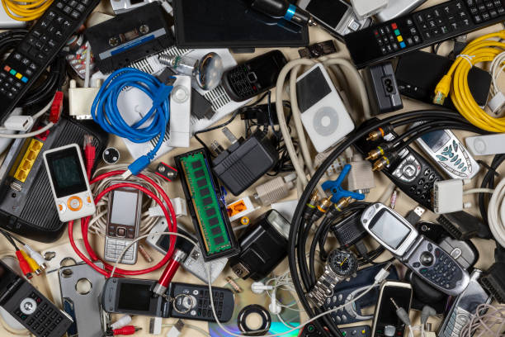
WHAT THE PILOT SOUGHT TO ACHIEVE
Create an efficient system for collecting, handling and managing ICT e-waste designed to be scalable and replicable nationwide
Create and EoL management and disposal plan for the ICT devices distributed through UCUSAF
*The pilot was designed as a learning Platform rather than a volume maximization exercise

Slide 5
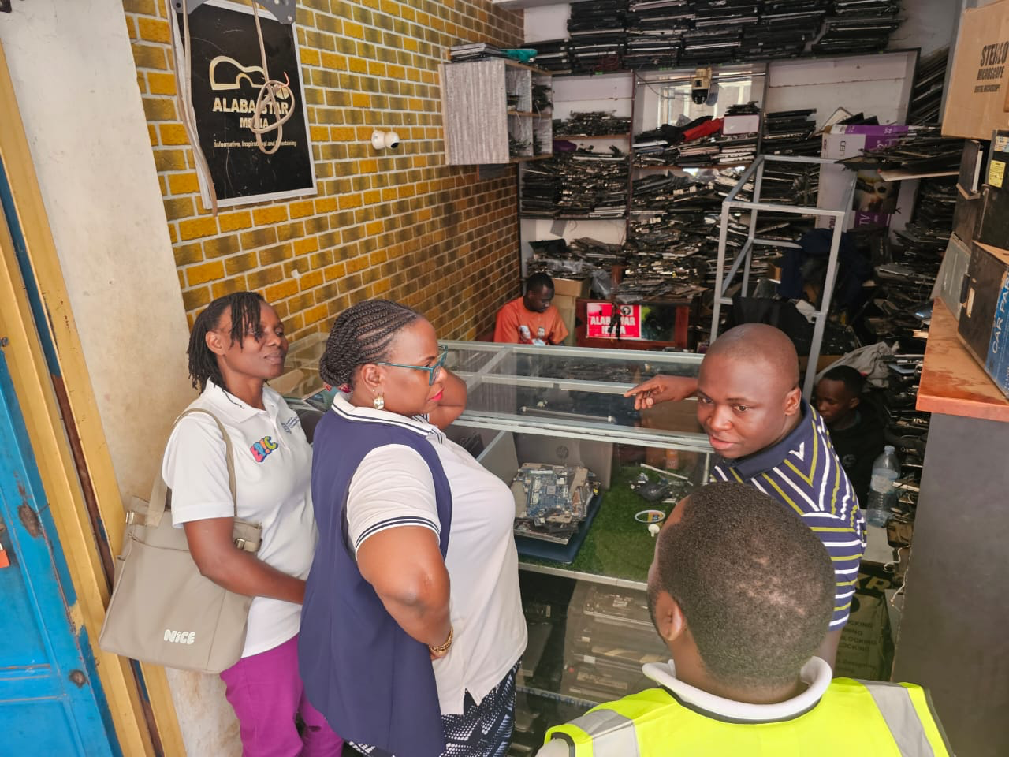
WHEN AND WHERE THE PILOT WAS CONDUCTED
Implementation period
July 2025 – January 2026 (24 weeks/6 months)
Pilot districts
Kampala, Wakiso, Mukono
High ICT penetration
Dense urban population
Active repair and secondary markets

Slide 6
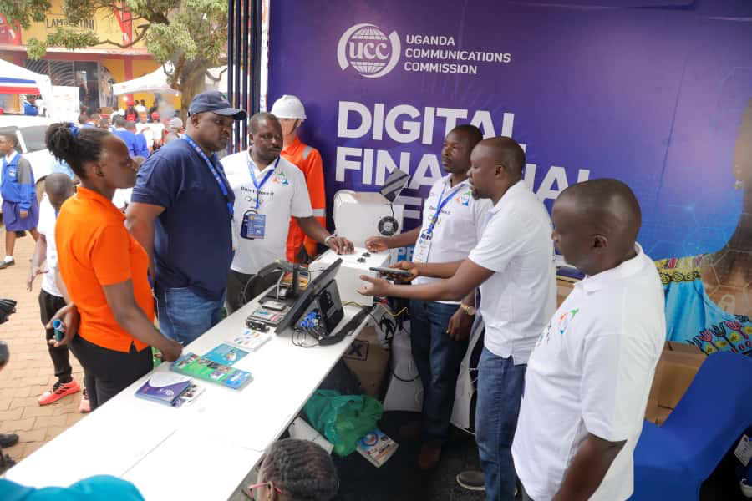
HOW THE PILOT WAS IMPLEMENTED
Through a structured multi-stakeholder model
Lead institution: UCC
Two ImPlementing Partners
Towa Uchafu Na Nusu
VAS Ltd
Government partners included
MoICT&NG
NEMA
KCCA
Local Government
Luwero Industries Limited

Slide 7

WHAT WAS DONE
System design → site profiling → bins deployment
Partnerships and collaborations
Awareness (media engagements and community engagements)
E-wastepreneurs Track: 97 youth trained (safe handling, record-keeping, financial literacy)
Traceability toolkit, chatbot, green chain App
What was collected: phones, laptops/PCs, boards, radios, STBs and peripherals | 3720 ktons so far
What’s not (insight): hoarding due to data-security fears, perceived value, emotional attachment, and awareness gaps
Institutional barrier identified: PPDA disposal rules focus on finance, not environment/data wiping → stockpiles and informal flows
Next Steps (Phase 2 – National Rollout)
Corporate collections
Deepen partnerships with schools, ICT retailers, local councils/districts, other key stakeholders
Institutional pathway: align PPDA + environmental compliance (EPR framework) + data sanitization SOPs
UCUSAF integration: link with community ICT projects for scale
Strengthen reward app engagement and public “where to dispose” awareness
Benefits management - hand over project, commercialisation opportunities, integration into national waste management framework

Slide 8
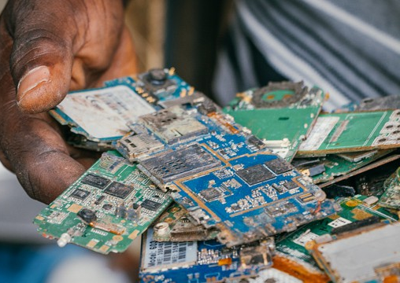
EXPECTED OUTCOMES
Functional national framework: SOPs, templates, and a traceability dashboard ready for scale-up
Reduced unsafe handling/dumping, increased secure handover
Policy inputs to EPR regulation & PPDA alignment on ICT assets
Livelihoods & inclusion: empowered e-wastepreneurs and repair-shop linkages
Evidence base for national roll-out (costs, volumes, location heatmaps, behaviour insights)

Slide 9
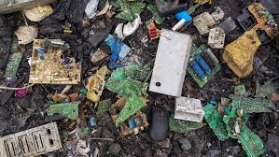
Thank you!
Questions?
Helen Nakiguli
nakiguli@ucc.co.ug
+256 772 433448

