Slide 1





SWITCH to Circular Economy
in East and Southern Africa
SWITCH-2-CE in ESA
Implemented by

Slide 2
SWITCH-2-CE in ESA Programme
About the Programme
Co-funded by the European Union and Federal Ministry for Economic Cooperation and Development (BMZ).
Implemented by GIZ and Expertise France
52 months programme commencing April 2025 and ending July 2029
Objectives
S01: Establish an enabling policy framework for circular economy across the ESA region
SO2: Enhance the participation of formal and informal workers and SMEs, including women and youth, in circular economy models
SO 3: Improve access to and use of financing by circular economy businesses
ESA region covering 13 countries and three RECs
COMESA, EAC and SADC
Angola, Botswana, Burundi, Ethiopia, Kenya, Malawi, Mozambique, Namibia, Rwanda, South Africa, Tanzania, Uganda and Zambia
Geographical Scope

Slide 3

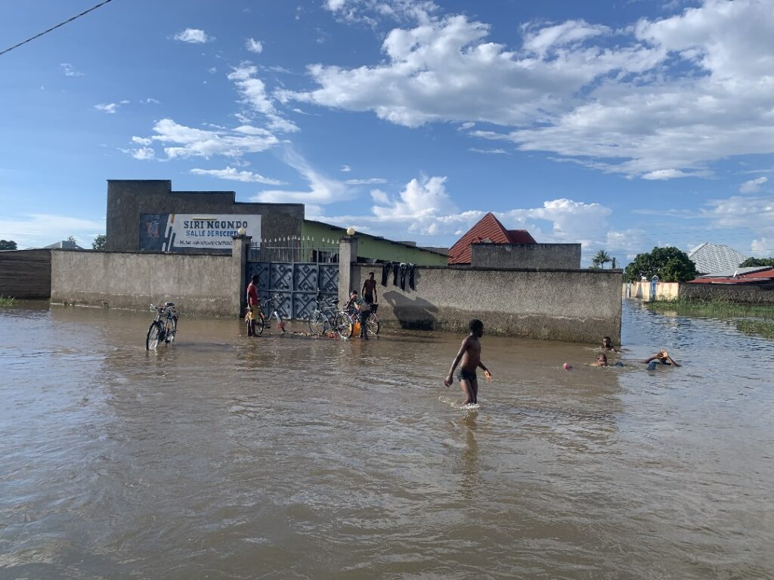



Circular Economy Transition in ESA
Growing Plastic and Electronic Waste Problem
Rising Climate Vulnerabilities Adaptation Costs
AU CEAP 2024-34 creates a Roadmap for CE transition in Africa

Slide 4
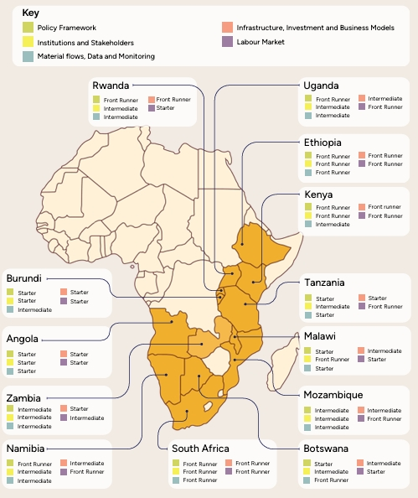
At What Stage is ESA in Transitioning to CE?
CE Maturity Assessment
Key Findings
Countries are at different levels of overall CE Progress.
National progress is uneven across dimensions. A country can be a starter in certain areas while simultaneously acting as a frontrunner in others.
Constraints to CE Transition in ESA
Limited & inconsistent data undermines effective policy design & monitoring.
Circular economy concepts remain poorly understood, with fragmented policy frameworks.
Weak Institutional coordination and limited Technical Capacity.
Insufficient regional harmonisation on waste, plastics and e-waste.

Slide 5


SWITCH-2-CE in ESA Work Packages
WP 1
Regional Studies
Producing high-quality regional analytical studies on key thematic areas of CE in the ESA region to strengthen evidence-based policymaking.
Develop actionable recommendations to guide the development of CE strategies, frameworks, and legislation.
Topics to be identified based on the demand in the ESA region.
Topic example: Strengthening regional CE data frameworks.

Slide 6

SWITCH-2-CE in ESA Work Packages
WP 2
Regional Policy Dialogues
Project aims to support the formation, operationalization and/or strengthening of regional working groups (RWGs).
Support CE transition in the ESA region by facilitating dialogue, knowledge exchange, and the sharing of best practices among policymakers.
Provide technical inputs and background materials to inform discussions and decision-making within the RWGs.
Facilitate study tours.

Slide 7

SWITCH-2-CE in ESA Work Packages
WP 3
Policy Support Facility
Policy Support Facility
€500,000 demand-driven TA Facility.
TA will be provided for
  CE Policy development i.e Roadmaps, strategies, Action Plans, Policies, and CE data frameworks.
  CE Governance and coordination mechanisms (i,e CE committees)
  Regional harmonisation
Target beneficiaries: Ministries & Agencies, RECs & Business Councils, and relevant CE institutions.
Applicants should submit an expression of interest

Slide 8

SWITCH-2-CE in ESA Work Packages
WP 4
Capacity Building
Tailored support to policy makers in public institutions and advocacy organisations involved in CE.
Aim: Strengthen policymakers’ understanding of CE principles.
Support includes:
  Training - online and in-person.
  Policy learning events - webinars, workshops and forums
  Knowledge products - Toolkits, briefs, case studies)

Slide 9

SWITCH-2-CE in ESA Work Packages
WP 5
Advocacy Support
Tailored support to strengthen CE advocacy organisations to effectively advocate for CE policy reforms in ESA.
Support includes:
  Engagement platforms linking advocacy actors and policymakers.
  Production of CE Advocacy and communication products (policy briefs, fact sheets) to strengthen evidence-based advocacy messaging.
  Conferences, workshops and knowledge exchange events

Slide 10








Benefits to ESA Policy Makers
Stronger policy coherence
Increased investor confidence
Resilient, sustainable growth
Harmonised regional standards
Faster cross-ministry coordination
Improved trade competitiveness

Slide 11
Contact Details
For more information on the Programme and work packages contact
Lewis Chimfwembe
Technical Lead on CE Policy Frameworks
lewis.chimfwembe@expertisefrance.fr
Valentin Grange
Programme Co-Lead
valentin.grange@expertisefrance.fr

